Slide 1


Group presentation
Zhicheng Du

Slide 2

Content
1、Adolescent mental health screening
2、Fundus RPPG

Slide 3
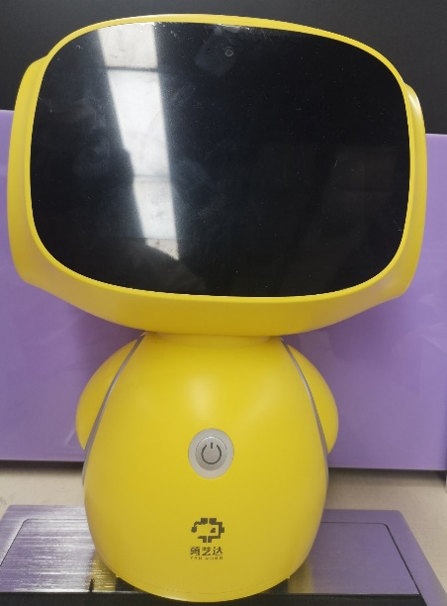
Adolescent mental health screening
Face Image
Physical index
Healthy:322
417 samples
Unhealthy:95
Answer text
Voice recording

Slide 4
Procedure
Face landmarks
Eye location
Healthy
Multimodal feature fusion
Classification model
Physical index
Unhealthy
Answer text
Voice recording

Slide 5
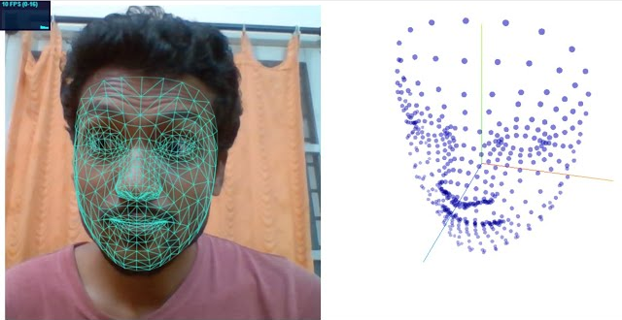
Feature extraction - Face
Mediapipe face mesh landmarks
Face Image
3 x 468 landmarks (x, y, z)

Slide 6
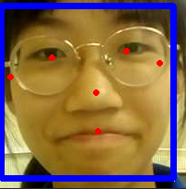
Feature extraction – Eye movement
Mediapipe eye location
Eye movements have long been studied as an approach to users’ behaviors and cognitive states in Human-computer interaction(HCI).
Face Image
1 x 4 Eye location (x, y)

Slide 7
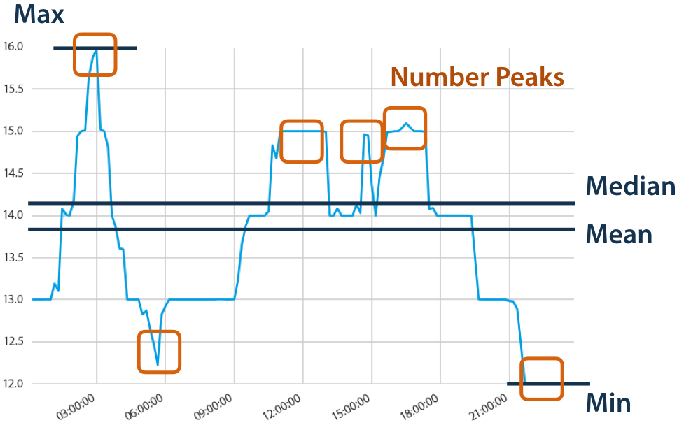
Feature extraction – Physical index
Tsfresh for physical index(br, hr, hrv, deltabp, stress, relax)
Tsfresh is used for systematic feature engineering from time-series and other sequential data.
Various length physical index series(6, len)
1 x 4722 feature

Slide 8
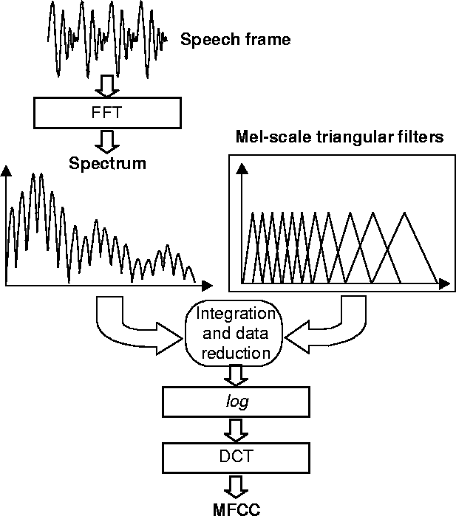
Feature extraction - Voice
MFCC(Mel-Frequency Cepstral Coefficients)
& Fbank(Filter Banks)
Wav file
MFCC : 1 x 9828
Fbank : 1 x 19656
Fbank Feature

Slide 9

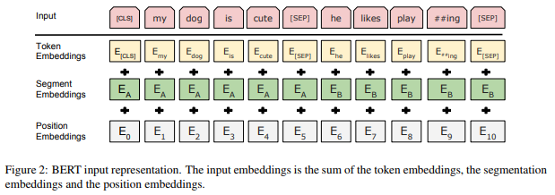
Feature extraction - Text
BERT variants for Chinese : Pert、Macbert、ELECTRA、RoBERT
Text
1 x 1024 feature

Slide 10
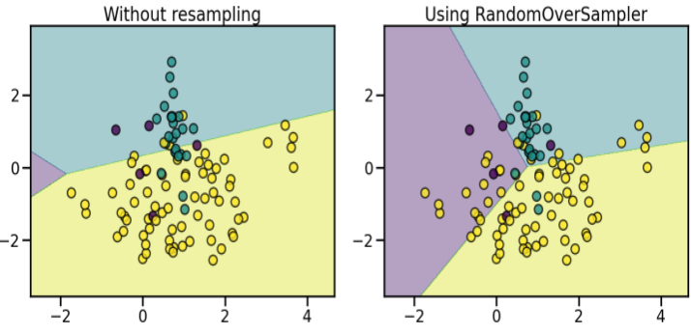
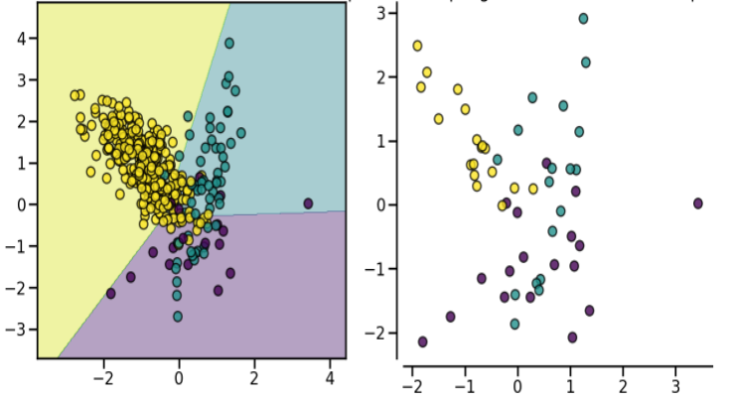
Imbalanced dataset
1、Weighted class
2、Over Sampling/ Under Sampling/ Synthetic Data
3、One-class classification(OCC)
Train : test = 7 : 3

Slide 11
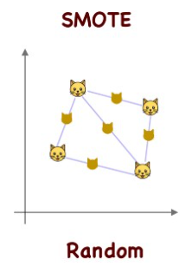
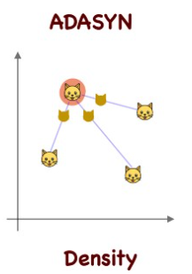
Synthetic Data
1、SMOTE(Synthetic Minority Over-sampling Technique)
2、ADASYN(Adaptive Synthetic)
3、SMOTE+ENN、SMOTE+TOMEK

Slide 12
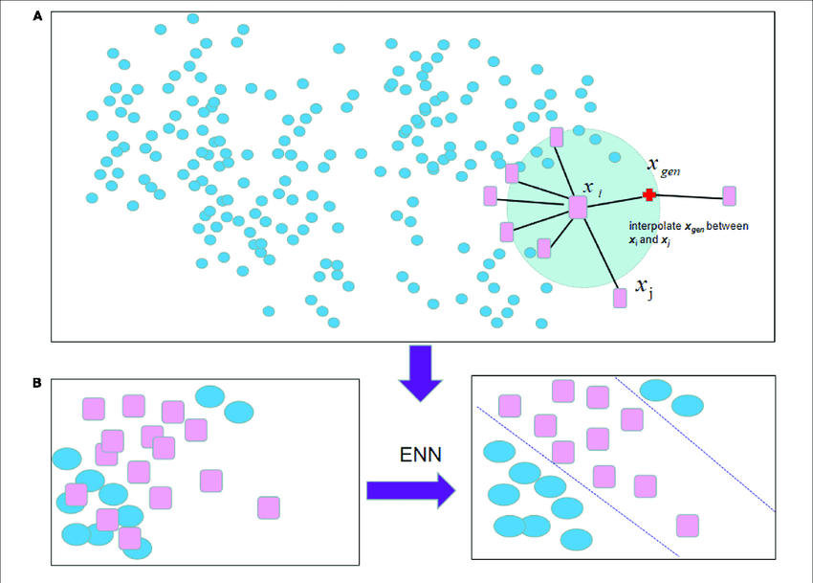
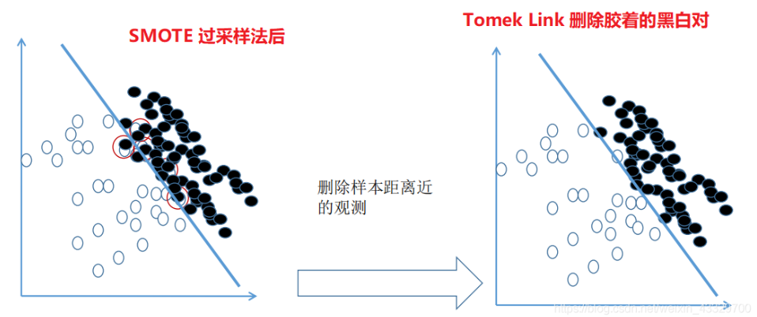
Synthetic Data
1、SMOTE(Synthetic Minority Over-sampling Technique)
2、ADASYN(Adaptive Synthetic)
3、SMOTE+ENN(N=3)、SMOTE+TOMEK

Slide 13
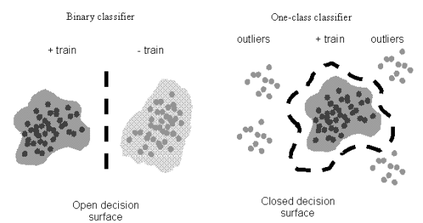
One-class classification(OCC)
1、One-class SVM(RBF : Radial basis function, Poly, Linear)
2、Isolation Forest
3、Minimum Covariance Determinant
4、Local Outlier Factor

Slide 14
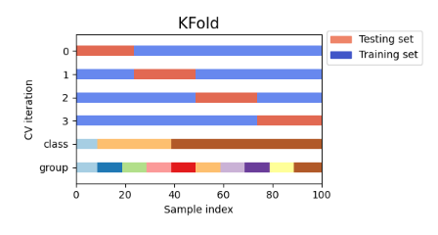
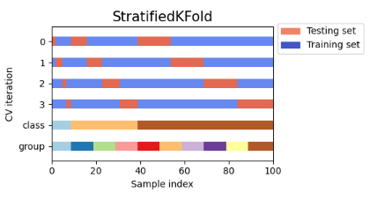
Evaluation method
1、Random splitting(70% : 30 %)
2、K-Folds cross-validator(K=10, 90% : 10%)
3、Stratified K-Folds cross-validator(K=10, 90% : 10%)

Slide 15
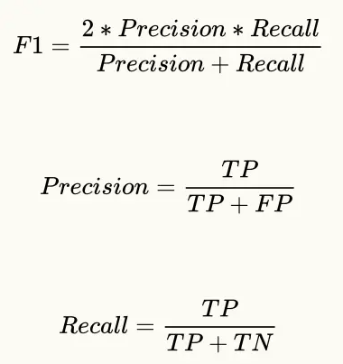
Single modal Experiment
Logistic regression
Random splitting
Accuracy
SVM(RBF、Poly、Linear)
Extracted Feature
K-Folds
F1-Score
Random Forest
Stratified K-Folds
Average Accuracy
Gradient Boosted Decision Tree
Deep learning classification

Slide 16
Multimodal Experiment (to do)
Logistic regression
Random splitting
Accuracy
SVM(RBF、Poly、Linear)
Fused Feature
K-Folds
F1-Score
Random Forest
Stratified K-Folds
Average Accuracy
Gradient Boosted Decision Tree
Deep learning classification

Slide 17
Results Face
face(468) | 417(322:95) | 70%:30% | class weight=balaced
 | SVM(RBF) | SVM(Poly) | SVM(Linear) | RF(N=100) | LR | GBDT(N=100)
acc | 0.230159 | 0.603175 | 0.634921 | 0.785714 | 0.603175 | 0.746032
f1 | 0.097048921 | 0.62524865 | 0.657387057 | 0.71142899 | 0.631373 | 0.664646465
RandomOverSampler |  | train:224/224
 | SVM(RBF) | SVM(Poly) | SVM(Linear) | RF(N=100) | LR | GBDT(N=100)
acc | 0.380952 | 0.619048 | 0.626984 | 0.738095 | 0.626984 | 0.730159
f1 | 0.411904762 | 0.637666993 | 0.652704438 | 0.691465 | 0.650931 | 0.67759742
10-fold | SVM(RBF) | SVM(Poly) | SVM(Linear) | RF(N=100) | LR | GBDT(N=100)
max_acc | 0.780487805 | 0.738095238 | 0.761904762 | 1 | 0.738095 | 0.952380952
min_acc | 0 | 0.341463415 | 0.365853659 | 0 | 0.414634 | 0
avg_acc | 0.153542393 | 0.565272938 | 0.536585366 | 0.75400697 | 0.55122 | 0.701626016
10-fold | SVM(RBF) | SVM(Poly) | SVM(Linear) | RF(N=100) | LR | GBDT(N=100)
max_acc | 0.536585366 | 0.761904762 | 0.761904762 | 0.928571 | 0.714286 | 0.904761905
min_acc | 0.119047619 | 0.414634146 | 0.476190476 | 0 | 0.439024 | 0.048780488
avg_acc | 0.341753775 | 0.560511034 | 0.553600465 | 0.670616 | 0.558304 | 0.654297329
Stratified 10-fold | SVM(RBF) | SVM(Poly) | SVM(Linear) | RF(N=100) | LR | GBDT(N=100)
max_acc | 0.761904762 | 0.69047619 | 0.738095238 | 0.7804878 | 0.714286 | 0.785714286
min_acc | 0.219512195 | 0.452380952 | 0.452380952 | 0.73809524 | 0.487805 | 0.69047619
avg_acc | 0.334901278 | 0.554006969 | 0.570615563 | 0.76027875 | 0.56324 | 0.741231127
Stratified 10-fold | SVM(RBF) | SVM(Poly) | SVM(Linear) | RF(N=100) | LR | GBDT(N=100)
max_acc | 0.547619048 | 0.69047619 | 0.69047619 | 0.761905 | 0.690476 | 0.761904762
min_acc | 0.261904762 | 0.404761905 | 0.428571429 | 0.642857 | 0.428571 | 0.642857143
avg_acc | 0.359349593 | 0.518176539 | 0.547038328 | 0.70029 | 0.558885 | 0.719628339
Oneclass classification |  |  | 70%:30% | Gaussian distributed dataset
OC SVM(RBF) | OC SVM(Poly) | OC SVM(Linear) | Isolation Forest(N=100) | Minimum Covariance Determinant | Local Outlier Factor(N=20)
0.468254 | 0.492063 | 0.492063 | 0.738095 | 0.222222 | 0.746032
0.510305583 | 0.533650537 | 0.533650537 | 0.672196621 | 0.080808081 | 0.664646465
RandomUnderSampler |  | train:67/67
 | SVM(RBF) | SVM(Poly) | SVM(Linear) | RF(N=100) | LR | GBDT(N=100)
acc | 0.468254 | 0.619048 | 0.555556 | 0.492063 | 0.555556 | 0.52381
f1 | 0.509011685 | 0.631465761 | 0.59121447 | 0.534759 | 0.590137 | 0.563932003
10-fold | SVM(RBF) | SVM(Poly) | SVM(Linear) | RF(N=100) | LR | GBDT(N=100)
max_acc | 0.785714286 | 0.738095238 | 0.666666667 | 0.571429 | 0.666667 | 0.595238095
min_acc | 0.142857143 | 0.195121951 | 0.317073171 | 0.380952 | 0.452381 | 0.380952381
avg_acc | 0.41010453 | 0.56445993 | 0.534262485 | 0.472416 | 0.529791 | 0.479500581
Stratified 10-fold | SVM(RBF) | SVM(Poly) | SVM(Linear) | RF(N=100) | LR | GBDT(N=100)
max_acc | 0.609756098 | 0.595238095 | 0.69047619 | 0.547619 | 0.690476 | 0.585365854
min_acc | 0.285714286 | 0.428571429 | 0.452380952 | 0.333333 | 0.428571 | 0.404761905
avg_acc | 0.494599303 | 0.546864111 | 0.556329849 | 0.455575 | 0.544425 | 0.503890825

Slide 18
Results Face
SMOTE |  | train:224/224
 | SVM(RBF) | SVM(Poly) | SVM(Linear) | RF(N=100) | LR | GBDT(N=100)
acc | 0.309524 | 0.611111 | 0.603175 | 0.642857 | 0.595238 | 0.65873
f1 | 0.323681 | 0.636077 | 0.631373 | 0.635441 | 0.624783 | 0.646245895
ADASYN |  | train:224/217
 | SVM(RBF) | SVM(Poly) | SVM(Linear) | RF(N=100) | LR | GBDT(N=100)
acc | 0.444444 | 0.603175 | 0.603175 | 0.626984 | 0.595238 | 0.666667
f1 | 0.487734 | 0.619533 | 0.62963 | 0.619239 | 0.623147 | 0.662177329
10-fold | SVM(RBF) | SVM(Poly) | SVM(Linear) | RF(N=100) | LR | GBDT(N=100)
max_acc | 0.878049 | 0.714286 | 0.714286 | 0.833333 | 0.666667 | 0.857142857
min_acc | 0.02381 | 0.404762 | 0.414634 | 0.073171 | 0.439024 | 0.12195122
avg_acc | 0.552497 | 0.539489 | 0.501045 | 0.618583 | 0.531998 | 0.616492451
Stratified 10-fold | SVM(RBF) | SVM(Poly) | SVM(Linear) | RF(N=100) | LR | GBDT(N=100)
max_acc | 0.761905 | 0.642857 | 0.690476 | 0.756098 | 0.714286 | 0.780487805
min_acc | 0.214286 | 0.428571 | 0.404762 | 0.595238 | 0.47619 | 0.571428571
avg_acc | 0.424623 | 0.522938 | 0.539431 | 0.664808 | 0.553775 | 0.657259001
10-fold | SVM(RBF) | SVM(Poly) | SVM(Linear) | RF(N=100) | LR | GBDT(N=100)
max_acc | 0.853659 | 0.714286 | 0.761905 | 0.880952 | 0.738095 | 0.904761905
min_acc | 0.119048 | 0.390244 | 0.390244 | 0.121951 | 0.439024 | 0.195121951
avg_acc | 0.359233 | 0.555923 | 0.526945 | 0.659292 | 0.543728 | 0.638037166
Stratified 10-fold | SVM(RBF) | SVM(Poly) | SVM(Linear) | RF(N=100) | LR | GBDT(N=100)
max_acc | 0.463415 | 0.690476 | 0.690476 | 0.731707 | 0.690476 | 0.731707317
min_acc | 0.261905 | 0.452381 | 0.428571 | 0.595238 | 0.47619 | 0.547619048
avg_acc | 0.374448 | 0.563531 | 0.556388 | 0.662021 | 0.556388 | 0.659698026
SMOTEENN |  | train：70/170
 | SVM(RBF) | SVM(Poly) | SVM(Linear) | RF(N=100) | LR | GBDT(N=100)
acc | 0.365079 | 0.579365 | 0.539683 | 0.34127 | 0.492063 | 0.484127
f1 | 0.400199 | 0.612635 | 0.578376 | 0.385185 | 0.5343 | 0.52682525
10-fold | SVM(RBF) | SVM(Poly) | SVM(Linear) | RF(N=100) | LR | GBDT(N=100)
max_acc | 0.928571 | 0.512195 | 0.560976 | 0.560976 | 0.52381 | 0.585365854
min_acc | 0 | 0.309524 | 0.357143 | 0.166667 | 0.404762 | 0.357142857
avg_acc | 0.54518 | 0.467654 | 0.486934 | 0.353775 | 0.491463 | 0.430023229
Stratified 10-fold | SVM(RBF) | SVM(Poly) | SVM(Linear) | RF(N=100) | LR | GBDT(N=100)
max_acc | 0.619048 | 0.560976 | 0.560976 | 0.5 | 0.619048 | 0.56097561
min_acc | 0.219512 | 0.428571 | 0.357143 | 0.238095 | 0.428571 | 0.380952381
avg_acc | 0.309001 | 0.489257 | 0.477526 | 0.369396 | 0.506098 | 0.446109175
SMOTETomek |  |  | train:222/222
 | SVM(RBF) | SVM(Poly) | SVM(Linear) | RF(N=100) | LR | GBDT(N=100)
acc | 0.309524 | 0.595238 | 0.603175 | 0.650794 | 0.587302 | 0.650794
f1 | 0.323681 | 0.621223 | 0.627595 | 0.640855 | 0.614815 | 0.635027503
10-fold | SVM(RBF) | SVM(Poly) | SVM(Linear) | RF(N=100) | LR | GBDT(N=100)
max_acc | 0.853659 | 0.738095 | 0.785714 | 0.880952 | 0.761905 | 0.904761905
min_acc | 0.119048 | 0.390244 | 0.414634 | 0.073171 | 0.439024 | 0.170731707
avg_acc | 0.364053 | 0.558246 | 0.531823 | 0.642451 | 0.55813 | 0.647735192
Stratified 10-fold | SVM(RBF) | SVM(Poly) | SVM(Linear) | RF(N=100) | LR | GBDT(N=100)
max_acc | 0.463415 | 0.690476 | 0.690476 | 0.738095 | 0.690476 | 0.731707317
min_acc | 0.261905 | 0.452381 | 0.452381 | 0.595238 | 0.5 | 0.571428571
avg_acc | 0.379268 | 0.56597 | 0.553949 | 0.685947 | 0.55633 | 0.652497096

Slide 19
Results Face
1、Random splitting: Best Acc(0.785714), Best F1-score(0.71142899), Random Forest
2、10-folds: Best average Acc(0.75400697), Random Forest
3、Stratified 10-folds: Best average Acc(0.76027875), Random Forest

Slide 20
Results Eye
iris(4) | 417(322:95) |  | 70%:30% | class weight=balaced
 | SVM(RBF) | SVM(Poly) | SVM(Linear) | RF(N=100) | LR | GBDT(N=100)
acc | 0.595238 | 0.587302 | 0.222222 | 0.746032 | 0.547619 | 0.761905
f1 | 0.618991051 | 0.607472575 | 0.080808081 | 0.67668046 | 0.5834 | 0.715527136
10-fold | SVM(RBF) | SVM(Poly) | SVM(Linear) | RF(N=100) | LR | GBDT(N=100)
max_acc | 0.666666667 | 0.785714286 | 0.682926829 | 1 | 0.634146 | 0.976190476
min_acc | 0.390243902 | 0.292682927 | 0 | 0 | 0.452381 | 0.024390244
avg_acc | 0.550813008 | 0.600696864 | 0.068292683 | 0.73246225 | 0.522938 | 0.720847851
Stratified 10-fold | SVM(RBF) | SVM(Poly) | SVM(Linear) | RF(N=100) | LR | GBDT(N=100)
max_acc | 0.658536585 | 0.714285714 | 0.785714286 | 0.80952381 | 0.666667 | 0.804878049
min_acc | 0.452380952 | 0.523809524 | 0.219512195 | 0.71428571 | 0.414634 | 0.666666667
avg_acc | 0.556620209 | 0.61387921 | 0.342044135 | 0.75058072 | 0.546632 | 0.743495935
RandomOverSampler |  | train:224/224
 | SVM(RBF) | SVM(Poly) | SVM(Linear) | RF(N=100) | LR | GBDT(N=100)
acc | 0.603175 | 0.595238 | 0.555556 | 0.698413 | 0.555556 | 0.65873
f1 | 0.62524865 | 0.610229277 | 0.592029332 | 0.672952 | 0.588783 | 0.651643964
10-fold | SVM(RBF) | SVM(Poly) | SVM(Linear) | RF(N=100) | LR | GBDT(N=100)
max_acc | 0.714285714 | 0.785714286 | 0.829268293 | 0.928571 | 0.690476 | 0.857142857
min_acc | 0.390243902 | 0.292682927 | 0.341463415 | 0.04878 | 0.487805 | 0.073170732
avg_acc | 0.552961672 | 0.593263647 | 0.583217189 | 0.677758 | 0.558479 | 0.594657375
Stratified 10-fold | SVM(RBF) | SVM(Poly) | SVM(Linear) | RF(N=100) | LR | GBDT(N=100)
max_acc | 0.833333333 | 0.761904762 | 0.80952381 | 0.809524 | 0.619048 | 0.756097561
min_acc | 0.428571429 | 0.523809524 | 0.243902439 | 0.609756 | 0.414634 | 0.523809524
avg_acc | 0.5757259 | 0.604297329 | 0.501045296 | 0.700116 | 0.541986 | 0.642682927
RandomUnderSampler |  | train:67/67
 | SVM(RBF) | SVM(Poly) | SVM(Linear) | RF(N=100) | LR | GBDT(N=100)
acc | 0.579365 | 0.650794 | 0.722222 | 0.619048 | 0.468254 | 0.595238
f1 | 0.601389449 | 0.650793651 | 0.695652174 | 0.642491 | 0.510306 | 0.628113494
10-fold | SVM(RBF) | SVM(Poly) | SVM(Linear) | RF(N=100) | LR | GBDT(N=100)
max_acc | 0.904761905 | 0.833333333 | 0.928571429 | 0.642857 | 0.682927 | 0.69047619
min_acc | 0.285714286 | 0.219512195 | 0.214285714 | 0.414634 | 0.390244 | 0.357142857
avg_acc | 0.563182346 | 0.574041812 | 0.574970964 | 0.5223 | 0.486992 | 0.496399535
Stratified 10-fold | SVM(RBF) | SVM(Poly) | SVM(Linear) | RF(N=100) | LR | GBDT(N=100)
max_acc | 0.738095238 | 0.619047619 | 0.761904762 | 0.658537 | 0.619048 | 0.571428571
min_acc | 0.292682927 | 0.512195122 | 0.292682927 | 0.365854 | 0.333333 | 0.380952381
avg_acc | 0.569860627 | 0.572938444 | 0.608013937 | 0.499013 | 0.448548 | 0.481997677
Oneclass classification |  |  |  | 70%:30%
OC SVM(RBF) | OC SVM(Poly) | OC SVM(Linear) | Isolation Forest(N=100) | Minimum Covariance Determinant | Local Outlier Factor（N=20)
0.468254 | 0.468254 | 0.468254 | 0.68254 | 0.714286 | 0.698413
0.512161583 | 0.503703704 | 0.503703704 | 0.662309368 | 0.667924528 | 0.639667705

Slide 21
Results Eye
SMOTE |  | train:224/224
 | SVM(RBF) | SVM(Poly) | SVM(Linear) | RF(N=100) | LR | GBDT(N=100)
acc | 0.634921 | 0.603175 | 0.507937 | 0.65873 | 0.571429 | 0.603175
f1 | 0.64997 | 0.61611 | 0.549396 | 0.664754 | 0.605814 | 0.622569784
10-fold | SVM(RBF) | SVM(Poly) | SVM(Linear) | RF(N=100) | LR | GBDT(N=100)
max_acc | 0.756098 | 0.785714 | 0.95122 | 0.904762 | 0.761905 | 0.738095238
min_acc | 0.365854 | 0.243902 | 0.341463 | 0.170732 | 0.439024 | 0.195121951
avg_acc | 0.565563 | 0.569454 | 0.554762 | 0.616434 | 0.546283 | 0.552497096
Stratified 10-fold | SVM(RBF) | SVM(Poly) | SVM(Linear) | RF(N=100) | LR | GBDT(N=100)
max_acc | 0.682927 | 0.714286 | 0.585366 | 0.756098 | 0.658537 | 0.738095238
min_acc | 0.47619 | 0.5 | 0.243902 | 0.536585 | 0.390244 | 0.487804878
avg_acc | 0.568641 | 0.604355 | 0.455691 | 0.649826 | 0.539663 | 0.604239257
ADASYN |  | train:224/220
 | SVM(RBF) | SVM(Poly) | SVM(Linear) | RF(N=100) | LR | GBDT(N=100)
acc | 0.611111 | 0.634921 | 0.777778 | 0.674603 | 0.571429 | 0.650794
f1 | 0.625514 | 0.634921 | 0.680556 | 0.680347 | 0.603469 | 0.665189125
10-fold | SVM(RBF) | SVM(Poly) | SVM(Linear) | RF(N=100) | LR | GBDT(N=100)
max_acc | 0.619048 | 0.785714 | 1 | 0.825397 | 0.857143 | 0.714285714
min_acc | 0.365854 | 0.341463 | 0 | 0.66129 | 0.195122 | 0.268292683
avg_acc | 0.52741 | 0.591173 | 0.834146 | 0.747081 | 0.609524 | 0.509988386
Stratified 10-fold | SVM(RBF) | SVM(Poly) | SVM(Linear) | RF(N=100) | LR | GBDT(N=100)
max_acc | 0.619048 | 0.714286 | 0.785714 | 0.738095 | 0.666667 | 0.738095238
min_acc | 0.365854 | 0.52381 | 0.214286 | 0.52381 | 0.317073 | 0.365853659
avg_acc | 0.52741 | 0.599535 | 0.284901 | 0.642625 | 0.532172 | 0.587224158
SMOTEENN |  | train：79/146
 | SVM(RBF) | SVM(Poly) | SVM(Linear) | RF(N=100) | LR | GBDT(N=100)
acc | 0.626984 | 0.595238 | 0.777778 | 0.515873 | 0.47619 | 0.484127
f1 | 0.633568 | 0.621223 | 0.680556 | 0.556424 | 0.519077 | 0.527546089
10-fold | SVM(RBF) | SVM(Poly) | SVM(Linear) | RF(N=100) | LR | GBDT(N=100)
max_acc | 0.761905 | 0.642857 | 1 | 0.714286 | 0.756098 | 0.642857143
min_acc | 0.414634 | 0.390244 | 0 | 0.365854 | 0.390244 | 0.333333333
avg_acc | 0.599129 | 0.500523 | 0.568293 | 0.498142 | 0.501452 | 0.491173055
Stratified 10-fold | SVM(RBF) | SVM(Poly) | SVM(Linear) | RF(N=100) | LR | GBDT(N=100)
max_acc | 0.738095 | 0.642857 | 0.785714 | 0.761905 | 0.619048 | 0.69047619
min_acc | 0.47619 | 0.390244 | 0.214286 | 0.317073 | 0.380952 | 0.317073171
avg_acc | 0.589895 | 0.570616 | 0.620906 | 0.541521 | 0.503659 | 0.512659698
SMOTETomek |  |  | train:207/207
 | SVM(RBF) | SVM(Poly) | SVM(Linear) | RF(N=100) | LR | GBDT(N=100)
acc | 0.626984 | 0.603175 | 0.5 | 0.68254 | 0.563492 | 0.611111
f1 | 0.643832 | 0.61611 | 0.541806 | 0.689815 | 0.598946 | 0.631473264
10-fold | SVM(RBF) | SVM(Poly) | SVM(Linear) | RF(N=100) | LR | GBDT(N=100)
max_acc | 0.756098 | 0.761905 | 0.95122 | 0.809524 | 0.761905 | 0.738095238
min_acc | 0.365854 | 0.243902 | 0.341463 | 0.146341 | 0.439024 | 0.268292683
avg_acc | 0.567944 | 0.576597 | 0.552381 | 0.599477 | 0.548722 | 0.557200929
Stratified 10-fold | SVM(RBF) | SVM(Poly) | SVM(Linear) | RF(N=100) | LR | GBDT(N=100)
max_acc | 0.658537 | 0.714286 | 0.585366 | 0.761905 | 0.658537 | 0.80952381
min_acc | 0.5 | 0.47619 | 0.243902 | 0.536585 | 0.390244 | 0.476190476
avg_acc | 0.570964 | 0.597271 | 0.448548 | 0.645006 | 0.539663 | 0.596689895

Slide 22
Results Eye
1、Random splitting: Best Acc(0.761905), Best F1-score(0.715527136), GBDT
2、10-folds: Best average Acc(0.834146), SVM(Linear) + ADASYN
3、Stratified 10-folds: Best average Acc(0.75058072), Random Forest

Slide 23
Results Physical signs
physical index(4722) |  | 417(322:95) | 70%:30% | class weight=balaced
 | SVM(RBF) | SVM(Poly) | SVM(Linear) | RF(N=100) | LR | GBDT(N=100)
acc | 0.222222 | 0.222222 | 0.603175 | 0.746032 | 0.428571 | 0.738095
f1 | 0.080808081 | 0.080808081 | 0.622569784 | 0.66464646 | 0.453852 | 0.672196621
10-fold | SVM(RBF) | SVM(Poly) | SVM(Linear) | RF(N=100) | LR | GBDT(N=100)
max_acc | 1 | 1 | 0.785714286 | 1 | 0.804878 | 1
min_acc | 0 | 0 | 0.170731707 | 0 | 0.142857 | 0
avg_acc | 0.245993031 | 0.295993031 | 0.575900116 | 0.7587108 | 0.442857 | 0.715969803
Stratified 10-fold | SVM(RBF) | SVM(Poly) | SVM(Linear) | RF(N=100) | LR | GBDT(N=100)
max_acc | 0.261904762 | 0.30952381 | 0.714285714 | 0.78571429 | 0.642857 | 0.785714286
min_acc | 0.214285714 | 0.214285714 | 0.512195122 | 0.71428571 | 0.292683 | 0.69047619
avg_acc | 0.230139373 | 0.234901278 | 0.627932636 | 0.76027875 | 0.426655 | 0.741056911
RandomOverSampler |  | train:224/224
 | SVM(RBF) | SVM(Poly) | SVM(Linear) | RF(N=100) | LR | GBDT(N=100)
acc | 0.222222 | 0.222222 | 0.595238 | 0.746032 | 0.690476 | 0.698413
f1 | 0.080808081 | 0.080808081 | 0.618991051 | 0.664646 | 0.684049 | 0.639667705
10-fold | SVM(RBF) | SVM(Poly) | SVM(Linear) | RF(N=100) | LR | GBDT(N=100)
max_acc | 1 | 1 | 0.80952381 | 1 | 0.880952 | 0.952380952
min_acc | 0 | 0 | 0.219512195 | 0 | 0.146341 | 0
avg_acc | 0.31504065 | 0.331707317 | 0.626190476 | 0.739605 | 0.671545 | 0.689721254
Stratified 10-fold | SVM(RBF) | SVM(Poly) | SVM(Linear) | RF(N=100) | LR | GBDT(N=100)
max_acc | 0.785714286 | 0.69047619 | 0.785714286 | 0.785714 | 0.785714 | 0.80952381
min_acc | 0.214285714 | 0.214285714 | 0.585365854 | 0.707317 | 0.309524 | 0.619047619
avg_acc | 0.282520325 | 0.272996516 | 0.668757259 | 0.743438 | 0.650232 | 0.724390244
Oneclass classification |  |  |  | 70%:30%
OC SVM(RBF) | OC SVM(Poly) | OC SVM(Linear) | Isolation Forest(N=100) | Minimum Covariance Determinant | Local Outlier Factor（N=20)
0.222222 | 0.277778 | 0.547619 | 0.769841 | 0.507937 | 0.650794
0.080808081 | 0.218942347 | 0.583400405 | 0.676631789 | 0.548223958 | 0.655014417
RandomUnderSampler |  | train:67/67
 | SVM(RBF) | SVM(Poly) | SVM(Linear) | RF(N=100) | LR | GBDT(N=100)
acc | 0.611111 | 0.761905 | 0.492063 | 0.571429 | 0.515873 | 0.515873
f1 | 0.639497803 | 0.706790123 | 0.532763533 | 0.607143 | 0.556352 | 0.556620176
10-fold | SVM(RBF) | SVM(Poly) | SVM(Linear) | RF(N=100) | LR | GBDT(N=100)
max_acc | 0.952380952 | 1 | 0.619047619 | 0.690476 | 0.595238 | 0.595238095
min_acc | 0.146341463 | 0 | 0.292682927 | 0.341463 | 0.317073 | 0.341463415
avg_acc | 0.590592334 | 0.725493612 | 0.467421603 | 0.497967 | 0.512718 | 0.486585366
Stratified 10-fold | SVM(RBF) | SVM(Poly) | SVM(Linear) | RF(N=100) | LR | GBDT(N=100)
max_acc | 0.829268293 | 0.785714286 | 0.634146341 | 0.642857 | 0.738095 | 0.642857143
min_acc | 0.238095238 | 0.238095238 | 0.404761905 | 0.380952 | 0.439024 | 0.452380952
avg_acc | 0.52398374 | 0.581416957 | 0.527642276 | 0.498374 | 0.596632 | 0.512950058

Slide 24
Results Physical signs
SMOTE |  | train:224/224
 | SVM(RBF) | SVM(Poly) | SVM(Linear) | RF(N=100) | LR | GBDT(N=100)
acc | 0.222222 | 0.222222 | 0.595238 | 0.738095 | 0.674603 | 0.611111
f1 | 0.080808 | 0.080808 | 0.618991 | 0.672197 | 0.667847 | 0.603036145
10-fold | SVM(RBF) | SVM(Poly) | SVM(Linear) | RF(N=100) | LR | GBDT(N=100)
max_acc | 1 | 1 | 0.809524 | 1 | 0.880952 | 0.952380952
min_acc | 0 | 0 | 0.268293 | 0 | 0.146341 | 0
avg_acc | 0.307898 | 0.324564 | 0.638386 | 0.720616 | 0.671487 | 0.692044135
Stratified 10-fold | SVM(RBF) | SVM(Poly) | SVM(Linear) | RF(N=100) | LR | GBDT(N=100)
max_acc | 0.666667 | 0.333333 | 0.785714 | 0.809524 | 0.785714 | 0.80952381
min_acc | 0.214286 | 0.214286 | 0.585366 | 0.658537 | 0.52381 | 0.69047619
avg_acc | 0.270616 | 0.237282 | 0.680546 | 0.750465 | 0.681185 | 0.726538908
ADASYN |  | train:224/215
 | SVM(RBF) | SVM(Poly) | SVM(Linear) | RF(N=100) | LR | GBDT(N=100)
acc | 0.222222 | 0.222222 | 0.603175 | 0.769841 | 0.68254 | 0.674603
f1 | 0.080808 | 0.080808 | 0.627595 | 0.71193 | 0.678264 | 0.643478261
10-fold | SVM(RBF) | SVM(Poly) | SVM(Linear) | RF(N=100) | LR | GBDT(N=100)
max_acc | 1 | 1 | 0.833333 | 0.952381 | 0.904762 | 0.952380952
min_acc | 0 | 0 | 0.170732 | 0 | 0.146341 | 0
avg_acc | 0.307898 | 0.326945 | 0.623693 | 0.708479 | 0.673868 | 0.677816492
Stratified 10-fold | SVM(RBF) | SVM(Poly) | SVM(Linear) | RF(N=100) | LR | GBDT(N=100)
max_acc | 0.738095 | 0.690476 | 0.666667 | 0.785714 | 0.785714 | 0.80952381
min_acc | 0.214286 | 0.214286 | 0.487805 | 0.707317 | 0.52381 | 0.642857143
avg_acc | 0.277758 | 0.272997 | 0.630139 | 0.750523 | 0.676423 | 0.724041812
SMOTEENN |  | train：66/121
 | SVM(RBF) | SVM(Poly) | SVM(Linear) | RF(N=100) | LR | GBDT(N=100)
acc | 0.222222 | 0.222222 | 0.539683 | 0.47619 | 0.738095 | 0.587302
f1 | 0.080808 | 0.080808 | 0.578468 | 0.513987 | 0.70665 | 0.620413437
10-fold | SVM(RBF) | SVM(Poly) | SVM(Linear) | RF(N=100) | LR | GBDT(N=100)
max_acc | 0.666667 | 0.952381 | 0.619048 | 0.642857 | 0.609756 | 0.69047619
min_acc | 0.292683 | 0.095238 | 0.292683 | 0.170732 | 0.292683 | 0.170731707
avg_acc | 0.483159 | 0.399652 | 0.45511 | 0.432753 | 0.495819 | 0.480952381
Stratified 10-fold | SVM(RBF) | SVM(Poly) | SVM(Linear) | RF(N=100) | LR | GBDT(N=100)
max_acc | 0.714286 | 0.619048 | 0.666667 | 0.642857 | 0.785714 | 0.714285714
min_acc | 0.214286 | 0.214286 | 0.404762 | 0.452381 | 0.333333 | 0.5
avg_acc | 0.515273 | 0.397561 | 0.536876 | 0.537108 | 0.558479 | 0.580313589
SMOTETomek |  |  | train:203/203
 | SVM(RBF) | SVM(Poly) | SVM(Linear) | RF(N=100) | LR | GBDT(N=100)
acc | 0.222222 | 0.222222 | 0.579365 | 0.722222 | 0.380952 | 0.674603
f1 | 0.080808 | 0.080808 | 0.606369 | 0.65233 | 0.411905 | 0.626645603
10-fold | SVM(RBF) | SVM(Poly) | SVM(Linear) | RF(N=100) | LR | GBDT(N=100)
max_acc | 1 | 1 | 0.761905 | 1 | 1 | 0.904761905
min_acc | 0 | 0 | 0.146341 | 0 | 0.170732 | 0
avg_acc | 0.303136 | 0.23885 | 0.549768 | 0.710976 | 0.721545 | 0.6514518
Stratified 10-fold | SVM(RBF) | SVM(Poly) | SVM(Linear) | RF(N=100) | LR | GBDT(N=100)
max_acc | 0.666667 | 0.261905 | 0.714286 | 0.785714 | 0.785714 | 0.780487805
min_acc | 0.214286 | 0.214286 | 0.547619 | 0.707317 | 0.634146 | 0.658536585
avg_acc | 0.270616 | 0.230139 | 0.611208 | 0.743206 | 0.716899 | 0.695470383

Slide 25
Results Physical index
1、Random splitting: Best Acc(0.769841), Best F1-score(0.71193), Random Forest + ADASYN
2、10-folds: Best average Acc(0.7587108), Random Forest
3、Stratified 10-folds: Best average Acc(0.76027875), Random Forest

Slide 26
Results Voice MFCC
Voice_MFCC(9828) |  | 417(322:95) | 70%:30% | class weight=balaced
 | SVM(RBF) | SVM(Poly) | SVM(Linear) | RF(N=100) | LR | GBDT(N=100)
acc | 0.626984 | 0.714286 | 0.722222 | 0.777778 | 0.730159 | 0.68254
f1 | 0.637389256 | 0.683566434 | 0.68887158 | 0.68055556 | 0.69418 | 0.631027254
10-fold | SVM(RBF) | SVM(Poly) | SVM(Linear) | RF(N=100) | LR | GBDT(N=100)
max_acc | 0.738095238 | 0.904761905 | 0.880952381 | 1 | 0.880952 | 1
min_acc | 0.12195122 | 0.024390244 | 0.024390244 | 0 | 0.02439 | 0.048780488
avg_acc | 0.52804878 | 0.632578397 | 0.649245064 | 0.76829268 | 0.644483 | 0.728164925
Stratified 10-fold | SVM(RBF) | SVM(Poly) | SVM(Linear) | RF(N=100) | LR | GBDT(N=100)
max_acc | 0.682926829 | 0.80952381 | 0.785714286 | 0.78571429 | 0.785714 | 0.804878049
min_acc | 0.476190476 | 0.619047619 | 0.666666667 | 0.76190476 | 0.642857 | 0.69047619
avg_acc | 0.595121951 | 0.719512195 | 0.72195122 | 0.77224158 | 0.712253 | 0.745934959
RandomOverSampler |  | train:224/224
 | SVM(RBF) | SVM(Poly) | SVM(Linear) | RF(N=100) | LR | GBDT(N=100)
acc | 0.738095 | 0.746032 | 0.722222 | 0.753968 | 0.730159 | 0.777778
f1 | 0.706650347 | 0.687242798 | 0.68887158 | 0.668678 | 0.69418 | 0.694494494
10-fold | SVM(RBF) | SVM(Poly) | SVM(Linear) | RF(N=100) | LR | GBDT(N=100)
max_acc | 0.857142857 | 0.928571429 | 0.880952381 | 1 | 0.857143 | 0.952380952
min_acc | 0.024390244 | 0 | 0.024390244 | 0 | 0.02439 | 0
avg_acc | 0.587224158 | 0.665795587 | 0.649245064 | 0.763531 | 0.637224 | 0.704006969
Stratified 10-fold | SVM(RBF) | SVM(Poly) | SVM(Linear) | RF(N=100) | LR | GBDT(N=100)
max_acc | 0.761904762 | 0.80952381 | 0.785714286 | 0.809524 | 0.785714 | 0.804878049
min_acc | 0.547619048 | 0.666666667 | 0.666666667 | 0.761905 | 0.619048 | 0.666666667
avg_acc | 0.681184669 | 0.738617886 | 0.72195122 | 0.774623 | 0.712311 | 0.729326365
Oneclass classification |  |  |  | 70%:30%
OC SVM(RBF) | OC SVM(Poly) | OC SVM(Linear) | Isolation Forest(N=100) | Minimum Covariance Determinant | Local Outlier Factor(N=20)
0.484127 | 0.579365 | 0.595238 | 0.753968 | 0.777778 | 0.777778
0.524923327 | 0.612635464 | 0.626147186 | 0.668677728 | 0.680555556 | 0.680555556
RandomUnderSampler |  | train:67/67
 | SVM(RBF) | SVM(Poly) | SVM(Linear) | RF(N=100) | LR | GBDT(N=100)
acc | 0.428571 | 0.484127 | 0.531746 | 0.492063 | 0.531746 | 0.484127
f1 | 0.462962963 | 0.524923327 | 0.570897701 | 0.531643 | 0.569702 | 0.524923327
10-fold | SVM(RBF) | SVM(Poly) | SVM(Linear) | RF(N=100) | LR | GBDT(N=100)
max_acc | 0.731707317 | 0.853658537 | 0.69047619 | 0.595238 | 0.642857 | 0.547619048
min_acc | 0.390243902 | 0.219512195 | 0.380952381 | 0.292683 | 0.333333 | 0.365853659
avg_acc | 0.489372822 | 0.484146341 | 0.51271777 | 0.457549 | 0.498316 | 0.436236934
Stratified 10-fold | SVM(RBF) | SVM(Poly) | SVM(Linear) | RF(N=100) | LR | GBDT(N=100)
max_acc | 0.658536585 | 0.682926829 | 0.634146341 | 0.585366 | 0.634146 | 0.682926829
min_acc | 0.404761905 | 0.333333333 | 0.357142857 | 0.428571 | 0.404762 | 0.428571429
avg_acc | 0.514053426 | 0.521370499 | 0.523170732 | 0.52288 | 0.52079 | 0.535075494

Slide 27
Results Voice MFCC
SMOTE |  | train:224/224
 | SVM(RBF) | SVM(Poly) | SVM(Linear) | RF(N=100) | LR | GBDT(N=100)
acc | 0.722222 | 0.68254 | 0.722222 | 0.753968 | 0.746032 | 0.738095
f1 | 0.672766 | 0.662309 | 0.688872 | 0.668678 | 0.704822 | 0.672196621
10-fold | SVM(RBF) | SVM(Poly) | SVM(Linear) | RF(N=100) | LR | GBDT(N=100)
max_acc | 0.928571 | 0.928571 | 0.880952 | 1 | 0.880952 | 0.904761905
min_acc | 0 | 0.04878 | 0.02439 | 0 | 0.02439 | 0.024390244
avg_acc | 0.687282 | 0.632636 | 0.649245 | 0.746864 | 0.641986 | 0.644483159
Stratified 10-fold | SVM(RBF) | SVM(Poly) | SVM(Linear) | RF(N=100) | LR | GBDT(N=100)
max_acc | 0.785714 | 0.761905 | 0.785714 | 0.785714 | 0.785714 | 0.80952381
min_acc | 0.738095 | 0.595238 | 0.666667 | 0.738095 | 0.642857 | 0.666666667
avg_acc | 0.762602 | 0.705285 | 0.721951 | 0.765099 | 0.709814 | 0.736469222
ADASYN |  | train:224/211
 | SVM(RBF) | SVM(Poly) | SVM(Linear) | RF(N=100) | LR | GBDT(N=100)
acc | 0.738095 | 0.674603 | 0.722222 | 0.761905 | 0.738095 | 0.722222
f1 | 0.682422 | 0.656971 | 0.688872 | 0.685606 | 0.699495 | 0.67276594
10-fold | SVM(RBF) | SVM(Poly) | SVM(Linear) | RF(N=100) | LR | GBDT(N=100)
max_acc | 0.97619 | 0.928571 | 0.880952 | 1 | 0.880952 | 0.928571429
min_acc | 0 | 0.04878 | 0.02439 | 0 | 0.02439 | 0.048780488
avg_acc | 0.684843 | 0.615912 | 0.649245 | 0.73734 | 0.644425 | 0.658943089
Stratified 10-fold | SVM(RBF) | SVM(Poly) | SVM(Linear) | RF(N=100) | LR | GBDT(N=100)
max_acc | 0.785714 | 0.785714 | 0.785714 | 0.785714 | 0.785714 | 0.780487805
min_acc | 0.707317 | 0.5 | 0.666667 | 0.738095 | 0.619048 | 0.642857143
avg_acc | 0.755401 | 0.688269 | 0.721951 | 0.760221 | 0.70511 | 0.722125436
SMOTEENN |  | train：10/214
 | SVM(RBF) | SVM(Poly) | SVM(Linear) | RF(N=100) | LR | GBDT(N=100)
acc | 0.277778 | 0.285714 | 0.261905 | 0.277778 | 0.277778 | 0.277778
f1 | 0.228164 | 0.212963 | 0.181459 | 0.209248 | 0.209248 | 0.209248448
10-fold | SVM(RBF) | SVM(Poly) | SVM(Linear) | RF(N=100) | LR | GBDT(N=100)
max_acc | 0.97561 | 0.97561 | 0.97561 | 0.97561 | 0.97561 | 0.951219512
min_acc | 0 | 0 | 0 | 0 | 0 | 0
avg_acc | 0.217073 | 0.221951 | 0.217015 | 0.22439 | 0.21928 | 0.235946574
Stratified 10-fold | SVM(RBF) | SVM(Poly) | SVM(Linear) | RF(N=100) | LR | GBDT(N=100)
max_acc | 0.309524 | 0.333333 | 0.309524 | 0.261905 | 0.309524 | 0.380952381
min_acc | 0.214286 | 0.214286 | 0.214286 | 0.214286 | 0.190476 | 0.195121951
avg_acc | 0.244483 | 0.242102 | 0.239779 | 0.230139 | 0.239779 | 0.258710801
SMOTETomek |  |  | train:222/222
 | SVM(RBF) | SVM(Poly) | SVM(Linear) | RF(N=100) | LR | GBDT(N=100)
acc | 0.722222 | 0.68254 | 0.738095 | 0.761905 | 0.738095 | 0.722222
f1 | 0.672766 | 0.662309 | 0.699495 | 0.685606 | 0.699495 | 0.652329749
10-fold | SVM(RBF) | SVM(Poly) | SVM(Linear) | RF(N=100) | LR | GBDT(N=100)
max_acc | 0.928571 | 0.928571 | 0.880952 | 1 | 0.880952 | 0.928571429
min_acc | 0 | 0.04878 | 0.02439 | 0 | 0.02439 | 0.024390244
avg_acc | 0.687282 | 0.630256 | 0.646864 | 0.73734 | 0.639605 | 0.668292683
Stratified 10-fold | SVM(RBF) | SVM(Poly) | SVM(Linear) | RF(N=100) | LR | GBDT(N=100)
max_acc | 0.785714 | 0.761905 | 0.785714 | 0.785714 | 0.785714 | 0.80952381
min_acc | 0.738095 | 0.595238 | 0.666667 | 0.738095 | 0.642857 | 0.666666667
avg_acc | 0.762602 | 0.705285 | 0.721951 | 0.765099 | 0.709814 | 0.736469222

Slide 28
Results Voice MFCC
1、Random splitting: Best Acc(0.777778), Best F1-score(0.694494494), GBDT + Over sampling
2、10-folds: Best average Acc(0.76829268), Random Forest
3、Stratified 10-folds: Best average Acc(0.774623), Random Forest + Over sampling

Slide 29
Results Voice Fbank
Voice_Logfbank(19656) |  | 417(322:95) | 70%:30% | class weight=balaced
 | SVM(RBF) | SVM(Poly) | SVM(Linear) | RF(N=100) | LR | GBDT(N=100)
acc | 0.420635 | 0.428571 | 0.642857 | 0.777778 | 0.65873 | 0.730159
f1 | 0.456819565 | 0.469803922 | 0.629792215 | 0.68055556 | 0.640238 | 0.667695473
10-fold | SVM(RBF) | SVM(Poly) | SVM(Linear) | RF(N=100) | LR | GBDT(N=100)
max_acc | 0.707317073 | 0.658536585 | 0.785714286 | 1 | 0.809524 | 1
min_acc | 0.333333333 | 0.365853659 | 0.073170732 | 0 | 0.097561 | 0.048780488
avg_acc | 0.518292683 | 0.5014518 | 0.604181185 | 0.76591173 | 0.599419 | 0.72340302
Stratified 10-fold | SVM(RBF) | SVM(Poly) | SVM(Linear) | RF(N=100) | LR | GBDT(N=100)
max_acc | 0.707317073 | 0.707317073 | 0.761904762 | 0.78571429 | 0.714286 | 0.804878049
min_acc | 0.357142857 | 0.452380952 | 0.536585366 | 0.76190476 | 0.560976 | 0.642857143
avg_acc | 0.516027875 | 0.542392567 | 0.661614402 | 0.76986063 | 0.663937 | 0.736527294
RandomOverSampler |  | train:224/224
 | SVM(RBF) | SVM(Poly) | SVM(Linear) | RF(N=100) | LR | GBDT(N=100)
acc | 0.420635 | 0.428571 | 0.642857 | 0.777778 | 0.65873 | 0.730159
f1 | 0.456819565 | 0.469803922 | 0.629792215 | 0.680556 | 0.640238 | 0.667695473
10-fold | SVM(RBF) | SVM(Poly) | SVM(Linear) | RF(N=100) | LR | GBDT(N=100)
max_acc | 0.714285714 | 0.738095238 | 0.785714286 | 1 | 0.833333 | 0.976190476
min_acc | 0.268292683 | 0.317073171 | 0.073170732 | 0 | 0.097561 | 0
avg_acc | 0.517711963 | 0.543786295 | 0.604181185 | 0.708711 | 0.606504 | 0.680023229
Stratified 10-fold | SVM(RBF) | SVM(Poly) | SVM(Linear) | RF(N=100) | LR | GBDT(N=100)
max_acc | 0.731707317 | 0.731707317 | 0.761904762 | 0.785714 | 0.738095 | 0.780487805
min_acc | 0.404761905 | 0.428571429 | 0.536585366 | 0.642857 | 0.560976 | 0.666666667
avg_acc | 0.566492451 | 0.540301974 | 0.661614402 | 0.741289 | 0.673577 | 0.717189315
Oneclass classification |  |  |  | 70%:30%
OC SVM(RBF) | OC SVM(Poly) | OC SVM(Linear) | Isolation Forest(N=100) | Minimum Covariance Determinant | Local Outlier Factor（N=20)
0.571429 | 0.555556 | 0.484127 | 0.738095 | - | 0.761905
0.607407407 | 0.593003203 | 0.526723924 | 0.682421957 | - | 0.696887929
RandomUnderSampler |  | train:67/67
 | SVM(RBF) | SVM(Poly) | SVM(Linear) | RF(N=100) | LR | GBDT(N=100)
acc | 0.444444 | 0.365079 | 0.484127 | 0.436508 | 0.460317 | 0.444444
f1 | 0.48625731 | 0.384995924 | 0.52682525 | 0.479699 | 0.505682 | 0.490640097
10-fold | SVM(RBF) | SVM(Poly) | SVM(Linear) | RF(N=100) | LR | GBDT(N=100)
max_acc | 0.951219512 | 0.951219512 | 0.571428571 | 0.619048 | 0.571429 | 0.571428571
min_acc | 0.317073171 | 0.238095238 | 0.43902439 | 0.214286 | 0.390244 | 0.30952381
avg_acc | 0.54738676 | 0.397502904 | 0.507955865 | 0.419686 | 0.495877 | 0.450754936
Stratified 10-fold | SVM(RBF) | SVM(Poly) | SVM(Linear) | RF(N=100) | LR | GBDT(N=100)
max_acc | 0.682926829 | 0.619047619 | 0.595238095 | 0.682927 | 0.595238 | 0.609756098
min_acc | 0.380952381 | 0.380952381 | 0.476190476 | 0.404762 | 0.47619 | 0.238095238
avg_acc | 0.539837398 | 0.474912892 | 0.541927991 | 0.506678 | 0.532288 | 0.441811847

Slide 30
Results Voice Fbank
SMOTE |  | train:224/224
 | SVM(RBF) | SVM(Poly) | SVM(Linear) | RF(N=100) | LR | GBDT(N=100)
acc | 0.365079 | 0.349206 | 0.642857 | 0.650794 | 0.650794 | 0.650794
f1 | 0.393169 | 0.369621 | 0.629792 | 0.621312 | 0.635028 | 0.650793651
10-fold | SVM(RBF) | SVM(Poly) | SVM(Linear) | RF(N=100) | LR | GBDT(N=100)
max_acc | 0.547619 | 0.609756 | 0.785714 | 0.880952 | 0.809524 | 0.857142857
min_acc | 0.285714 | 0.357143 | 0.073171 | 0.02439 | 0.097561 | 0.097560976
avg_acc | 0.420151 | 0.484785 | 0.604181 | 0.606388 | 0.6018 | 0.606678281
Stratified 10-fold | SVM(RBF) | SVM(Poly) | SVM(Linear) | RF(N=100) | LR | GBDT(N=100)
max_acc | 0.634146 | 0.707317 | 0.761905 | 0.731707 | 0.738095 | 0.756097561
min_acc | 0.357143 | 0.357143 | 0.536585 | 0.619048 | 0.560976 | 0.547619048
avg_acc | 0.513589 | 0.542276 | 0.661614 | 0.681185 | 0.671138 | 0.662195122
ADASYN |  | train:224/223
 | SVM(RBF) | SVM(Poly) | SVM(Linear) | RF(N=100) | LR | GBDT(N=100)
acc | 0.373016 | 0.47619 | 0.642857 | 0.698413 | 0.650794 | 0.698413
f1 | 0.406066 | 0.519077 | 0.629792 | 0.679194 | 0.635028 | 0.6791939
10-fold | SVM(RBF) | SVM(Poly) | SVM(Linear) | RF(N=100) | LR | GBDT(N=100)
max_acc | 0.634146 | 0.658537 | 0.785714 | 0.880952 | 0.809524 | 0.904761905
min_acc | 0.333333 | 0.357143 | 0.073171 | 0.02439 | 0.097561 | 0.097560976
avg_acc | 0.463298 | 0.496922 | 0.604181 | 0.608653 | 0.604181 | 0.618583043
Stratified 10-fold | SVM(RBF) | SVM(Poly) | SVM(Linear) | RF(N=100) | LR | GBDT(N=100)
max_acc | 0.666667 | 0.690476 | 0.761905 | 0.756098 | 0.738095 | 0.731707317
min_acc | 0.357143 | 0.452381 | 0.536585 | 0.52381 | 0.536585 | 0.595238095
avg_acc | 0.528107 | 0.558943 | 0.661614 | 0.676713 | 0.67108 | 0.652671312
SMOTEENN |  | train：75/164
 | SVM(RBF) | SVM(Poly) | SVM(Linear) | RF(N=100) | LR | GBDT(N=100)
acc | 0.309524 | 0.309524 | 0.531746 | 0.333333 | 0.531746 | 0.380952
f1 | 0.318271 | 0.318271 | 0.570503 | 0.354246 | 0.570968 | 0.420952873
10-fold | SVM(RBF) | SVM(Poly) | SVM(Linear) | RF(N=100) | LR | GBDT(N=100)
max_acc | 0.707317 | 0.731707 | 0.547619 | 0.463415 | 0.595238 | 0.571428571
min_acc | 0.285714 | 0.190476 | 0.243902 | 0.142857 | 0.243902 | 0.238095238
avg_acc | 0.427991 | 0.430546 | 0.431127 | 0.281359 | 0.445354 | 0.367131243
Stratified 10-fold | SVM(RBF) | SVM(Poly) | SVM(Linear) | RF(N=100) | LR | GBDT(N=100)
max_acc | 0.634146 | 0.666667 | 0.571429 | 0.5 | 0.595238 | 0.547619048
min_acc | 0.285714 | 0.333333 | 0.404762 | 0.166667 | 0.428571 | 0.333333333
avg_acc | 0.499535 | 0.549652 | 0.486411 | 0.378688 | 0.49367 | 0.453310105
SMOTETomek |  |  | train:222/222
 | SVM(RBF) | SVM(Poly) | SVM(Linear) | RF(N=100) | LR | GBDT(N=100)
acc | 0.357143 | 0.349206 | 0.650794 | 0.68254 | 0.634921 | 0.65873
f1 | 0.387471 | 0.369621 | 0.635028 | 0.655738 | 0.62453 | 0.656493873
10-fold | SVM(RBF) | SVM(Poly) | SVM(Linear) | RF(N=100) | LR | GBDT(N=100)
max_acc | 0.547619 | 0.634146 | 0.857143 | 0.928571 | 0.857143 | 0.833333333
min_acc | 0.285714 | 0.380952 | 0.04878 | 0 | 0.097561 | 0.048780488
avg_acc | 0.420151 | 0.501452 | 0.613705 | 0.644425 | 0.616086 | 0.611382114
Stratified 10-fold | SVM(RBF) | SVM(Poly) | SVM(Linear) | RF(N=100) | LR | GBDT(N=100)
max_acc | 0.658537 | 0.731707 | 0.761905 | 0.738095 | 0.738095 | 0.714285714
min_acc | 0.333333 | 0.404762 | 0.585366 | 0.634146 | 0.536585 | 0.571428571
avg_acc | 0.513589 | 0.549419 | 0.659292 | 0.688153 | 0.659175 | 0.664285714

Slide 31
Results Voice Fbank
1、Random splitting: Best Acc(0.761905), Best F1-score(0.696887929), Local Outlier Factor
2、10-folds: Best average Acc(0.76591173), Random Forest
3、Stratified 10-folds: Best average Acc(0.76986063), Random Forest

Slide 32
Results Text PERT
Text(PERT 1024) |  | 417(322:95) | 70%:30% | class weight=balaced
 | SVM(RBF) | SVM(Poly) | SVM(Linear) | RF(N=100) | LR | GBDT(N=100)
acc | 0.222222 | 0.222222 | 0.65873 | 0.785714 | 0.595238 | 0.746032
f1 | 0.080808081 | 0.080808081 | 0.668249745 | 0.72229141 | 0.627253 | 0.704821803
10-fold | SVM(RBF) | SVM(Poly) | SVM(Linear) | RF(N=100) | LR | GBDT(N=100)
max_acc | 0.682926829 | 0.682926829 | 0.880952381 | 1 | 0.761905 | 0.928571429
min_acc | 0 | 0 | 0.219512195 | 0 | 0.219512 | 0.073170732
avg_acc | 0.068292683 | 0.07804878 | 0.705981417 | 0.74936121 | 0.598722 | 0.733391405
Stratified 10-fold | SVM(RBF) | SVM(Poly) | SVM(Linear) | RF(N=100) | LR | GBDT(N=100)
max_acc | 0.785714286 | 0.785714286 | 0.80952381 | 0.83333333 | 0.833333 | 0.80952381
min_acc | 0.219512195 | 0.219512195 | 0.571428571 | 0.75609756 | 0.428571 | 0.707317073
avg_acc | 0.342044135 | 0.342044135 | 0.688385598 | 0.79361208 | 0.632985 | 0.774448316
RandomOverSampler |  | train:224/224
 | SVM(RBF) | SVM(Poly) | SVM(Linear) | RF(N=100) | LR | GBDT(N=100)
acc | 0.666667 | 0.666667 | 0.674603 | 0.801587 | 0.611111 | 0.753968
f1 | 0.662177329 | 0.662177329 | 0.680346984 | 0.766261 | 0.641871 | 0.730434783
10-fold | SVM(RBF) | SVM(Poly) | SVM(Linear) | RF(N=100) | LR | GBDT(N=100)
max_acc | 0.976190476 | 0.976190476 | 0.976190476 | 1 | 0.809524 | 0.928571429
min_acc | 0.219512195 | 0.219512195 | 0.243902439 | 0 | 0.317073 | 0.12195122
avg_acc | 0.780197445 | 0.768176539 | 0.723054588 | 0.732695 | 0.629965 | 0.702264808
Stratified 10-fold | SVM(RBF) | SVM(Poly) | SVM(Linear) | RF(N=100) | LR | GBDT(N=100)
max_acc | 0.756097561 | 0.761904762 | 0.80952381 | 0.857143 | 0.857143 | 0.833333333
min_acc | 0.571428571 | 0.571428571 | 0.595238095 | 0.756098 | 0.428571 | 0.658536585
avg_acc | 0.690824623 | 0.688327526 | 0.704936121 | 0.798374 | 0.649826 | 0.755052265
Oneclass classification |  |  |  | 70%:30%
OC SVM(RBF) | OC SVM(Poly) | OC SVM(Linear) | Isolation Forest(N=100) | Minimum Covariance Determinant | Local Outlier Factor（N=20)
0.515873 | 0.547619 | 0.547619 | 0.769841 | 0.253968 | 0.769841
0.555848606 | 0.584288747 | 0.584288747 | 0.728863208 | 0.155867406 | 0.711930364
RandomUnderSampler |  | train:67/67
 | SVM(RBF) | SVM(Poly) | SVM(Linear) | RF(N=100) | LR | GBDT(N=100)
acc | 0.619048 | 0.619048 | 0.626984 | 0.65873 | 0.563492 | 0.65873
f1 | 0.642490842 | 0.642490842 | 0.648874106 | 0.683640929 | 0.600255 | 0.682261507
10-fold | SVM(RBF) | SVM(Poly) | SVM(Linear) | RF(N=100) | LR | GBDT(N=100)
max_acc | 0.952380952 | 0.952380952 | 0.952380952 | 0.785714286 | 0.809524 | 0.857142857
min_acc | 0.243902439 | 0.243902439 | 0.292682927 | 0.476190476 | 0.292683 | 0.536585366
avg_acc | 0.761498258 | 0.759175377 | 0.756852497 | 0.616202091 | 0.616086 | 0.661440186
Stratified 10-fold | SVM(RBF) | SVM(Poly) | SVM(Linear) | RF(N=100) | LR | GBDT(N=100)
max_acc | 0.785714286 | 0.761904762 | 0.785714286 | 0.69047619 | 0.738095 | 0.714285714
min_acc | 0.523809524 | 0.523809524 | 0.5 | 0.585365854 | 0.404762 | 0.56097561
avg_acc | 0.693321719 | 0.683739837 | 0.688559814 | 0.645005807 | 0.592334 | 0.649593496

Slide 33
Results Text PERT
SMOTE |  | train:224/224
 | SVM(RBF) | SVM(Poly) | SVM(Linear) | RF(N=100) | LR | GBDT(N=100)
acc | 0.65873 | 0.65873 | 0.666667 | 0.746032 | 0.595238 | 0.746032
f1 | 0.66825 | 0.66825 | 0.680408 | 0.718726 | 0.627253 | 0.734565457
10-fold | SVM(RBF) | SVM(Poly) | SVM(Linear) | RF(N=100) | LR | GBDT(N=100)
max_acc | 0.880952 | 0.857143 | 0.833333 | 0.952381 | 0.785714 | 0.880952381
min_acc | 0.219512 | 0.219512 | 0.292683 | 0.097561 | 0.292683 | 0.219512195
avg_acc | 0.689024 | 0.684262 | 0.67741 | 0.733217 | 0.584553 | 0.698025552
Stratified 10-fold | SVM(RBF) | SVM(Poly) | SVM(Linear) | RF(N=100) | LR | GBDT(N=100)
max_acc | 0.833333 | 0.833333 | 0.804878 | 0.880952 | 0.809524 | 0.80952381
min_acc | 0.595238 | 0.595238 | 0.595238 | 0.658537 | 0.428571 | 0.609756098
avg_acc | 0.702555 | 0.704994 | 0.700232 | 0.78403 | 0.635424 | 0.745470383
ADASYN |  | train:224/227
 | SVM(RBF) | SVM(Poly) | SVM(Linear) | RF(N=100) | LR | GBDT(N=100)
acc | 0.777778 | 0.769841 | 0.650794 | 0.722222 | 0.571429 | 0.746032
f1 | 0.680556 | 0.690053 | 0.672283272 | 0.695652174 | 0.607143 | 0.742611298
10-fold | SVM(RBF) | SVM(Poly) | SVM(Linear) | RF(N=100) | LR | GBDT(N=100)
max_acc | 1 | 1 | 0.902439024 | 0.952380952 | 0.738095 | 0.928571429
min_acc | 0 | 0 | 0.268292683 | 0.097560976 | 0.333333 | 0.170731707
avg_acc | 0.219512 | 0.190244 | 0.737921022 | 0.718815331 | 0.603949 | 0.693147503
Stratified 10-fold | SVM(RBF) | SVM(Poly) | SVM(Linear) | RF(N=100) | LR | GBDT(N=100)
max_acc | 0.780488 | 0.780488 | 0.804878049 | 0.857142857 | 0.857143 | 0.833333333
min_acc | 0.214286 | 0.195122 | 0.595238095 | 0.69047619 | 0.404762 | 0.682926829
avg_acc | 0.497096 | 0.504181 | 0.681126597 | 0.769744483 | 0.628165 | 0.767305459
SMOTEENN |  | train：85/200
 | SVM(RBF) | SVM(Poly) | SVM(Linear) | RF(N=100) | LR | GBDT(N=100)
acc | 0.222222 | 0.34127 | 0.642857 | 0.595238 | 0.579365 | 0.65873
f1 | 0.094503 | 0.344133 | 0.665784764 | 0.628113 | 0.614598 | 0.682261507
10-fold | SVM(RBF) | SVM(Poly) | SVM(Linear) | RF(N=100) | LR | GBDT(N=100)
max_acc | 1 | 1 | 0.761904762 | 0.707317 | 0.756098 | 0.634146341
min_acc | 0 | 0 | 0.268292683 | 0.261905 | 0.292683 | 0.333333333
avg_acc | 0.153659 | 0.290244 | 0.577932636 | 0.439954 | 0.561382 | 0.506387921
Stratified 10-fold | SVM(RBF) | SVM(Poly) | SVM(Linear) | RF(N=100) | LR | GBDT(N=100)
max_acc | 0.785714 | 0.809524 | 0.833333333 | 0.619048 | 0.714286 | 0.658536585
min_acc | 0.195122 | 0.238095 | 0.5 | 0.452381 | 0.404762 | 0.476190476
avg_acc | 0.554007 | 0.622648 | 0.647212544 | 0.534785 | 0.575261 | 0.570673635
SMOTETomek |  |  | train:221/221
 | SVM(RBF) | SVM(Poly) | SVM(Linear) | RF(N=100) | LR | GBDT(N=100)
acc | 0.65873 | 0.65873 | 0.666667 | 0.769841 | 0.595238 | 0.761905
f1 | 0.66825 | 0.66825 | 0.6804078 | 0.74782609 | 0.627253 | 0.746732026
10-fold | SVM(RBF) | SVM(Poly) | SVM(Linear) | RF(N=100) | LR | GBDT(N=100)
max_acc | 0.880952 | 0.857143 | 0.83333333 | 0.95238095 | 0.785714 | 0.880952381
min_acc | 0.219512 | 0.219512 | 0.29268293 | 0.09756098 | 0.292683 | 0.219512195
avg_acc | 0.689024 | 0.684262 | 0.67740999 | 0.73315912 | 0.586992 | 0.705168409
Stratified 10-fold | SVM(RBF) | SVM(Poly) | SVM(Linear) | RF(N=100) | LR | GBDT(N=100)
max_acc | 0.833333 | 0.833333 | 0.80487805 | 0.88095238 | 0.809524 | 0.80952381
min_acc | 0.595238 | 0.595238 | 0.5952381 | 0.66666667 | 0.428571 | 0.634146341
avg_acc | 0.702555 | 0.702555 | 0.70023229 | 0.7937863 | 0.635424 | 0.748025552

Slide 34
Results Voice PERT
1、Random splitting: Best Acc(0.801587), Best F1-score(0.766261), Random Forest + Over Sampling
2、10-folds: Best average Acc(0.780197445), SVM(RBF) + Over Sampling
3、Stratified 10-folds: Best average Acc(0.798374), Random Forest + Over Sampling

Slide 35
Results Text RoBERT
Text(RoBERT 1024) |  | 417(322:95) | 70%:30% | class weight=balaced
 | SVM(RBF) | SVM(Poly) | SVM(Linear) | RF(N=100) | LR | GBDT(N=100)
acc | 0.515873 | 0.777778 | 0.753968 | 0.777778 | 0.753968 | 0.801587
f1 | 0.5461095 | 0.774784886 | 0.763080541 | 0.7170954 | 0.765081 | 0.782608696
10-fold | SVM(RBF) | SVM(Poly) | SVM(Linear) | RF(N=100) | LR | GBDT(N=100)
max_acc | 0.738095238 | 0.928571429 | 0.833333333 | 1 | 0.833333 | 0.952380952
min_acc | 0.243902439 | 0.341463415 | 0.414634146 | 0 | 0.439024 | 0.170731707
avg_acc | 0.591579559 | 0.775493612 | 0.740127758 | 0.74703833 | 0.730546 | 0.738269454
Stratified 10-fold | SVM(RBF) | SVM(Poly) | SVM(Linear) | RF(N=100) | LR | GBDT(N=100)
max_acc | 0.80952381 | 0.880952381 | 0.833333333 | 0.85714286 | 0.833333 | 0.904761905
min_acc | 0.585365854 | 0.731707317 | 0.658536585 | 0.73170732 | 0.609756 | 0.707317073
avg_acc | 0.685772358 | 0.776771196 | 0.735888502 | 0.78164925 | 0.742973 | 0.78873403
RandomOverSampler |  | train:224/224
 | SVM(RBF) | SVM(Poly) | SVM(Linear) | RF(N=100) | LR | GBDT(N=100)
acc | 0.777778 | 0.777778 | 0.738095 | 0.801587 | 0.746032 | 0.761905
f1 | 0.774784886 | 0.774784886 | 0.742718304 | 0.772345 | 0.754311 | 0.741803855
10-fold | SVM(RBF) | SVM(Poly) | SVM(Linear) | RF(N=100) | LR | GBDT(N=100)
max_acc | 0.928571429 | 0.857142857 | 0.857142857 | 0.97619 | 0.833333 | 0.976190476
min_acc | 0.390243902 | 0.463414634 | 0.390243902 | 0.073171 | 0.414634 | 0.170731707
avg_acc | 0.747038328 | 0.751974448 | 0.715969803 | 0.742567 | 0.730372 | 0.733449477
Stratified 10-fold | SVM(RBF) | SVM(Poly) | SVM(Linear) | RF(N=100) | LR | GBDT(N=100)
max_acc | 0.880952381 | 0.880952381 | 0.833333333 | 0.880952 | 0.857143 | 0.857142857
min_acc | 0.682926829 | 0.707317073 | 0.609756098 | 0.731707 | 0.634146 | 0.707317073
avg_acc | 0.771777003 | 0.779094077 | 0.721544715 | 0.800697 | 0.747793 | 0.776713124
Oneclass classification |  |  |  | 70%:30%
OC SVM(RBF) | OC SVM(Poly) | OC SVM(Linear) | Isolation Forest(N=100) | Minimum Covariance Determinant | Local Outlier Factor（N=20)
0.547619 | 0.5 | 0.5 | 0.769841 | 0.246032 | 0.769841
0.584973287 | 0.541286265 | 0.541286265 | 0.676631789 | 0.140946837 | 0.676631789
RandomUnderSampler |  | train:67/67
 | SVM(RBF) | SVM(Poly) | SVM(Linear) | RF(N=100) | LR | GBDT(N=100)
acc | 0.738095 | 0.738095 | 0.698413 | 0.698413 | 0.698413 | 0.690476
f1 | 0.749924585 | 0.749924585 | 0.719843439 | 0.716971917 | 0.719843 | 0.71306968
10-fold | SVM(RBF) | SVM(Poly) | SVM(Linear) | RF(N=100) | LR | GBDT(N=100)
max_acc | 0.857142857 | 0.880952381 | 0.833333333 | 0.880952381 | 0.833333 | 0.785714286
min_acc | 0.243902439 | 0.243902439 | 0.536585366 | 0.547619048 | 0.512195 | 0.547619048
avg_acc | 0.708246225 | 0.708188153 | 0.723635308 | 0.687746806 | 0.71899 | 0.681068525
Stratified 10-fold | SVM(RBF) | SVM(Poly) | SVM(Linear) | RF(N=100) | LR | GBDT(N=100)
max_acc | 0.880952381 | 0.880952381 | 0.785714286 | 0.785714286 | 0.857143 | 0.738095238
min_acc | 0.642857143 | 0.642857143 | 0.619047619 | 0.619047619 | 0.658537 | 0.619047619
avg_acc | 0.736004646 | 0.736062718 | 0.709756098 | 0.692915215 | 0.723868 | 0.680952381

Slide 36
Results Text RoBERT
SMOTE |  | train:224/224
 | SVM(RBF) | SVM(Poly) | SVM(Linear) | RF(N=100) | LR | GBDT(N=100)
acc | 0.746032 | 0.753968 | 0.738095 | 0.809524 | 0.738095 | 0.785714
f1 | 0.754311 | 0.758311 | 0.745401 | 0.784127 | 0.745401 | 0.769901401
10-fold | SVM(RBF) | SVM(Poly) | SVM(Linear) | RF(N=100) | LR | GBDT(N=100)
max_acc | 0.880952 | 0.904762 | 0.857143 | 0.952381 | 0.857143 | 0.928571429
min_acc | 0.292683 | 0.365854 | 0.341463 | 0.170732 | 0.365854 | 0.195121951
avg_acc | 0.737166 | 0.753949 | 0.696632 | 0.743089 | 0.72561 | 0.7029036
Stratified 10-fold | SVM(RBF) | SVM(Poly) | SVM(Linear) | RF(N=100) | LR | GBDT(N=100)
max_acc | 0.857143 | 0.857143 | 0.809524 | 0.857143 | 0.857143 | 0.857142857
min_acc | 0.690476 | 0.690476 | 0.609756 | 0.682927 | 0.634146 | 0.682926829
avg_acc | 0.752846 | 0.760163 | 0.726481 | 0.774448 | 0.738211 | 0.752845528
ADASYN |  | train:224/213
 | SVM(RBF) | SVM(Poly) | SVM(Linear) | RF(N=100) | LR | GBDT(N=100)
acc | 0.706349 | 0.746032 | 0.746032 | 0.777778 | 0.753968 | 0.769841
f1 | 0.726597 | 0.756501 | 0.751851852 | 0.748148148 | 0.763081 | 0.757369615
10-fold | SVM(RBF) | SVM(Poly) | SVM(Linear) | RF(N=100) | LR | GBDT(N=100)
max_acc | 0.880952 | 0.880952 | 0.80952381 | 0.976190476 | 0.857143 | 0.857142857
min_acc | 0.341463 | 0.439024 | 0.365853659 | 0.170731707 | 0.414634 | 0.268292683
avg_acc | 0.741986 | 0.75662 | 0.696980256 | 0.740708479 | 0.718583 | 0.700696864
Stratified 10-fold | SVM(RBF) | SVM(Poly) | SVM(Linear) | RF(N=100) | LR | GBDT(N=100)
max_acc | 0.857143 | 0.857143 | 0.833333333 | 0.829268293 | 0.857143 | 0.833333333
min_acc | 0.707317 | 0.658537 | 0.634146341 | 0.738095238 | 0.609756 | 0.69047619
avg_acc | 0.750465 | 0.745645 | 0.733449477 | 0.784204413 | 0.735714 | 0.764866434
SMOTEENN |  | train：84/205
 | SVM(RBF) | SVM(Poly) | SVM(Linear) | RF(N=100) | LR | GBDT(N=100)
acc | 0.738095 | 0.722222 | 0.68254 | 0.555556 | 0.674603 | 0.595238
f1 | 0.732657 | 0.729971 | 0.707240397 | 0.591168 | 0.699452 | 0.62932776
10-fold | SVM(RBF) | SVM(Poly) | SVM(Linear) | RF(N=100) | LR | GBDT(N=100)
max_acc | 0.857143 | 0.857143 | 0.780487805 | 0.853659 | 0.829268 | 0.780487805
min_acc | 0.341463 | 0.463415 | 0.428571429 | 0.214286 | 0.47619 | 0.357142857
avg_acc | 0.732695 | 0.754762 | 0.609233449 | 0.421487 | 0.645412 | 0.461440186
Stratified 10-fold | SVM(RBF) | SVM(Poly) | SVM(Linear) | RF(N=100) | LR | GBDT(N=100)
max_acc | 0.785714 | 0.785714 | 0.666666667 | 0.595238 | 0.785714 | 0.642857143
min_acc | 0.609756 | 0.547619 | 0.512195122 | 0.357143 | 0.536585 | 0.404761905
avg_acc | 0.716783 | 0.714402 | 0.618641115 | 0.472184 | 0.659292 | 0.522764228
SMOTETomek |  |  | train:224/224
 | SVM(RBF) | SVM(Poly) | SVM(Linear) | RF(N=100) | LR | GBDT(N=100)
acc | 0.746032 | 0.753968 | 0.738095 | 0.809524 | 0.738095 | 0.785714
f1 | 0.754311 | 0.758311 | 0.74540097 | 0.78412698 | 0.745401 | 0.769901401
10-fold | SVM(RBF) | SVM(Poly) | SVM(Linear) | RF(N=100) | LR | GBDT(N=100)
max_acc | 0.880952 | 0.904762 | 0.85714286 | 0.95238095 | 0.857143 | 0.928571429
min_acc | 0.292683 | 0.365854 | 0.34146341 | 0.17073171 | 0.365854 | 0.195121951
avg_acc | 0.737166 | 0.753949 | 0.69663182 | 0.74308943 | 0.72561 | 0.7029036
Stratified 10-fold | SVM(RBF) | SVM(Poly) | SVM(Linear) | RF(N=100) | LR | GBDT(N=100)
max_acc | 0.857143 | 0.857143 | 0.80952381 | 0.85714286 | 0.857143 | 0.857142857
min_acc | 0.690476 | 0.690476 | 0.6097561 | 0.68292683 | 0.634146 | 0.682926829
avg_acc | 0.752846 | 0.762544 | 0.72648084 | 0.77444832 | 0.738211 | 0.755226481

Slide 37
Results Text RoBERT
1、Random splitting: Best Acc(0.809524), Best F1-score(0.784127), Random Forest + SMOTE / Random Forest
+ SMOTETomek
2、10-folds: Best average Acc(0.775493612), SVM(Poly)
3、Stratified 10-folds: Best average Acc(0.800697), Random Forest + Over Sampling

Slide 38
Results Text MacBERT
Text(MacBERT 1024) |  | 417(322:95) | 70%:30% | class weight=balaced
 | SVM(RBF) | SVM(Poly) | SVM(Linear) | RF(N=100) | LR | GBDT(N=100)
acc | 0.246032 | 0.563492 | 0.722222 | 0.81746 | 0.706349 | 0.753968
f1 | 0.12861816 | 0.598945924 | 0.727125474 | 0.77865773 | 0.71454 | 0.730434783
10-fold | SVM(RBF) | SVM(Poly) | SVM(Linear) | RF(N=100) | LR | GBDT(N=100)
max_acc | 0.707317073 | 0.707317073 | 0.904761905 | 1 | 0.857143 | 0.928571429
min_acc | 0 | 0.119047619 | 0.463414634 | 0.02439024 | 0.463415 | 0.195121951
avg_acc | 0.151219512 | 0.370963995 | 0.768350755 | 0.75191638 | 0.735134 | 0.736062718
Stratified 10-fold | SVM(RBF) | SVM(Poly) | SVM(Linear) | RF(N=100) | LR | GBDT(N=100)
max_acc | 0.785714286 | 0.80952381 | 0.857142857 | 0.82926829 | 0.833333 | 0.829268293
min_acc | 0.219512195 | 0.292682927 | 0.69047619 | 0.75609756 | 0.619048 | 0.69047619
avg_acc | 0.370789779 | 0.531765389 | 0.767131243 | 0.79140534 | 0.738444 | 0.762659698
RandomOverSampler |  | train:224/224
 | SVM(RBF) | SVM(Poly) | SVM(Linear) | RF(N=100) | LR | GBDT(N=100)
acc | 0.634921 | 0.650794 | 0.738095 | 0.785714 | 0.738095 | 0.777778
f1 | 0.657387057 | 0.66786141 | 0.739721098 | 0.769901 | 0.739721 | 0.763616558
10-fold | SVM(RBF) | SVM(Poly) | SVM(Linear) | RF(N=100) | LR | GBDT(N=100)
max_acc | 0.857142857 | 0.857142857 | 0.904761905 | 0.928571 | 0.833333 | 0.904761905
min_acc | 0.43902439 | 0.414634146 | 0.463414634 | 0.121951 | 0.463415 | 0.195121951
avg_acc | 0.687398374 | 0.72514518 | 0.768408827 | 0.72381 | 0.720906 | 0.743437863
Stratified 10-fold | SVM(RBF) | SVM(Poly) | SVM(Linear) | RF(N=100) | LR | GBDT(N=100)
max_acc | 0.738095238 | 0.80952381 | 0.857142857 | 0.833333 | 0.833333 | 0.857142857
min_acc | 0.452380952 | 0.658536585 | 0.69047619 | 0.731707 | 0.642857 | 0.714285714
avg_acc | 0.614111498 | 0.714401858 | 0.764692218 | 0.776771 | 0.731243 | 0.791231127
RandomUnderSampler |  | train:67/67
 | SVM(RBF) | SVM(Poly) | SVM(Linear) | RF(N=100) | LR | GBDT(N=100)
acc | 0.507937 | 0.507937 | 0.706349 | 0.634921 | 0.674603 | 0.706349
f1 | 0.549297967 | 0.549396403 | 0.714540478 | 0.659259259 | 0.69704 | 0.719612414
10-fold | SVM(RBF) | SVM(Poly) | SVM(Linear) | RF(N=100) | LR | GBDT(N=100)
max_acc | 0.880952381 | 0.880952381 | 0.928571429 | 0.785714286 | 0.833333 | 0.714285714
min_acc | 0.365853659 | 0.43902439 | 0.463414634 | 0.56097561 | 0.487805 | 0.536585366
avg_acc | 0.62688734 | 0.638966318 | 0.763530778 | 0.646980256 | 0.694425 | 0.649767712
Stratified 10-fold | SVM(RBF) | SVM(Poly) | SVM(Linear) | RF(N=100) | LR | GBDT(N=100)
max_acc | 0.666666667 | 0.666666667 | 0.80952381 | 0.761904762 | 0.738095 | 0.761904762
min_acc | 0.452380952 | 0.463414634 | 0.714285714 | 0.56097561 | 0.619048 | 0.585365854
avg_acc | 0.546806039 | 0.541986063 | 0.755284553 | 0.671254355 | 0.688386 | 0.666202091
Oneclass classification |  |  |  | 70%:30%
OC SVM(RBF) | OC SVM(Poly) | OC SVM(Linear) | Isolation Forest(N=100) | Minimum Covariance Determinant | Local Outlier Factor（N=20)
0.484127 | 0.539683 | 0.539683 | 0.738095 | 0.301587 | 0.769841
0.52682525 | 0.578042328 | 0.577458951 | 0.660578387 | 0.249206349 | 0.676631789

Slide 39
Results Text MacBERT
SMOTE |  | train:224/224
 | SVM(RBF) | SVM(Poly) | SVM(Linear) | RF(N=100) | LR | GBDT(N=100)
acc | 0.515873 | 0.587302 | 0.706349 | 0.753968 | 0.706349 | 0.761905
f1 | 0.55662 | 0.618155 | 0.71454 | 0.744968 | 0.71454 | 0.755128205
10-fold | SVM(RBF) | SVM(Poly) | SVM(Linear) | RF(N=100) | LR | GBDT(N=100)
max_acc | 0.880952 | 0.809524 | 0.904762 | 0.904762 | 0.857143 | 0.880952381
min_acc | 0.404762 | 0.390244 | 0.463415 | 0.170732 | 0.463415 | 0.268292683
avg_acc | 0.625668 | 0.629617 | 0.763705 | 0.721719 | 0.713705 | 0.712659698
Stratified 10-fold | SVM(RBF) | SVM(Poly) | SVM(Linear) | RF(N=100) | LR | GBDT(N=100)
max_acc | 0.738095 | 0.809524 | 0.785714 | 0.809524 | 0.785714 | 0.880952381
min_acc | 0.452381 | 0.609756 | 0.690476 | 0.731707 | 0.658537 | 0.682926829
avg_acc | 0.575377 | 0.68101 | 0.745703 | 0.776829 | 0.716725 | 0.759930314
ADASYN |  | train:224/226
 | SVM(RBF) | SVM(Poly) | SVM(Linear) | RF(N=100) | LR | GBDT(N=100)
acc | 0.444444 | 0.579365 | 0.706349 | 0.777778 | 0.698413 | 0.769841
f1 | 0.487734 | 0.611486 | 0.714540478 | 0.771452991 | 0.708244 | 0.76142165
10-fold | SVM(RBF) | SVM(Poly) | SVM(Linear) | RF(N=100) | LR | GBDT(N=100)
max_acc | 0.904762 | 0.761905 | 0.904761905 | 0.952380952 | 0.833333 | 0.904761905
min_acc | 0 | 0.414634 | 0.487804878 | 0.195121951 | 0.487805 | 0.243902439
avg_acc | 0.367886 | 0.615796 | 0.763821138 | 0.728919861 | 0.713995 | 0.712659698
Stratified 10-fold | SVM(RBF) | SVM(Poly) | SVM(Linear) | RF(N=100) | LR | GBDT(N=100)
max_acc | 0.761905 | 0.785714 | 0.785714286 | 0.833333333 | 0.761905 | 0.80952381
min_acc | 0.214286 | 0.536585 | 0.682926829 | 0.756097561 | 0.619048 | 0.666666667
avg_acc | 0.441405 | 0.611208 | 0.740882695 | 0.779326365 | 0.707201 | 0.755458769
SMOTEENN |  | train：85/195
 | SVM(RBF) | SVM(Poly) | SVM(Linear) | RF(N=100) | LR | GBDT(N=100)
acc | 0.428571 | 0.444444 | 0.619048 | 0.539683 | 0.611111 | 0.626984
f1 | 0.471579 | 0.487734 | 0.646118028 | 0.578042 | 0.641871 | 0.656488053
10-fold | SVM(RBF) | SVM(Poly) | SVM(Linear) | RF(N=100) | LR | GBDT(N=100)
max_acc | 0.560976 | 0.595238 | 0.833333333 | 0.731707 | 0.738095 | 0.682926829
min_acc | 0.285714 | 0.357143 | 0.512195122 | 0.333333 | 0.536585 | 0.261904762
avg_acc | 0.441812 | 0.50151 | 0.740127758 | 0.456562 | 0.673461 | 0.537804878
Stratified 10-fold | SVM(RBF) | SVM(Poly) | SVM(Linear) | RF(N=100) | LR | GBDT(N=100)
max_acc | 0.595238 | 0.666667 | 0.80952381 | 0.642857 | 0.809524 | 0.69047619
min_acc | 0.380952 | 0.439024 | 0.585365854 | 0.380952 | 0.571429 | 0.476190476
avg_acc | 0.482056 | 0.551103 | 0.692682927 | 0.503194 | 0.654413 | 0.580313589
SMOTETomek |  |  | train:223/223
 | SVM(RBF) | SVM(Poly) | SVM(Linear) | RF(N=100) | LR | GBDT(N=100)
acc | 0.547619 | 0.603175 | 0.706349 | 0.753968 | 0.706349 | 0.746032
f1 | 0.585511 | 0.631373 | 0.71454048 | 0.7488596 | 0.71454 | 0.742611298
10-fold | SVM(RBF) | SVM(Poly) | SVM(Linear) | RF(N=100) | LR | GBDT(N=100)
max_acc | 0.880952 | 0.809524 | 0.9047619 | 0.95238095 | 0.857143 | 0.880952381
min_acc | 0.404762 | 0.414634 | 0.46341463 | 0.17073171 | 0.463415 | 0.268292683
avg_acc | 0.62079 | 0.627178 | 0.76126597 | 0.72171893 | 0.713705 | 0.702961672
Stratified 10-fold | SVM(RBF) | SVM(Poly) | SVM(Linear) | RF(N=100) | LR | GBDT(N=100)
max_acc | 0.738095 | 0.809524 | 0.80952381 | 0.83333333 | 0.785714 | 0.857142857
min_acc | 0.452381 | 0.609756 | 0.69047619 | 0.71428571 | 0.658537 | 0.714285714
avg_acc | 0.575377 | 0.678571 | 0.74808362 | 0.77444832 | 0.716725 | 0.757665505

Slide 40
Results Text MacBERT
1、Random splitting: Best Acc(0.81746), Best F1-score(0.77865773), Random Forest
2、10-folds: Best average Acc(0.768408827), SVM(Linear)
Forest + Over Sampling
3、Stratified 10-folds: Best average Acc(0.79140534), Random Forest

Slide 41
Results Text ELECTRA
Text(ELECTRA 1024) |  | 417(322:95) | 70%:30% | class weight=balaced
 | SVM(RBF) | SVM(Poly) | SVM(Linear) | RF(N=100) | LR | GBDT(N=100)
acc | 0.777778 | 0.777778 | 0.690476 | 0.777778 | 0.571429 | 0.714286
f1 | 0.680555556 | 0.680555556 | 0.679153253 | 0.68055556 | 0.601883 | 0.658632563
10-fold | SVM(RBF) | SVM(Poly) | SVM(Linear) | RF(N=100) | LR | GBDT(N=100)
max_acc | 1 | 1 | 0.904761905 | 1 | 0.833333 | 1
min_acc | 0 | 0 | 0.024390244 | 0 | 0.097561 | 0.024390244
avg_acc | 0.763530778 | 0.768292683 | 0.630313589 | 0.76829268 | 0.573519 | 0.751800232
Stratified 10-fold | SVM(RBF) | SVM(Poly) | SVM(Linear) | RF(N=100) | LR | GBDT(N=100)
max_acc | 0.785714286 | 0.785714286 | 0.80952381 | 0.78571429 | 0.738095 | 0.804878049
min_acc | 0.761904762 | 0.761904762 | 0.571428571 | 0.76190476 | 0.5 | 0.738095238
avg_acc | 0.77224158 | 0.77224158 | 0.688269454 | 0.77224158 | 0.613937 | 0.765098722
RandomOverSampler |  | train:224/224
 | SVM(RBF) | SVM(Poly) | SVM(Linear) | RF(N=100) | LR | GBDT(N=100)
acc | 0.777778 | 0.777778 | 0.690476 | 0.777778 | 0.571429 | 0.753968
f1 | 0.680555556 | 0.680555556 | 0.679153253 | 0.680556 | 0.601883 | 0.692063492
10-fold | SVM(RBF) | SVM(Poly) | SVM(Linear) | RF(N=100) | LR | GBDT(N=100)
max_acc | 1 | 1 | 0.904761905 | 1 | 0.833333 | 1
min_acc | 0 | 0 | 0.024390244 | 0 | 0.097561 | 0
avg_acc | 0.763530778 | 0.768292683 | 0.630313589 | 0.768293 | 0.573519 | 0.737398374
Stratified 10-fold | SVM(RBF) | SVM(Poly) | SVM(Linear) | RF(N=100) | LR | GBDT(N=100)
max_acc | 0.785714286 | 0.785714286 | 0.80952381 | 0.785714 | 0.738095 | 0.80952381
min_acc | 0.761904762 | 0.761904762 | 0.571428571 | 0.761905 | 0.5 | 0.69047619
avg_acc | 0.77224158 | 0.77224158 | 0.688269454 | 0.772242 | 0.613937 | 0.760278746
Oneclass classification |  |  |  | 70%:30%
OC SVM(RBF) | OC SVM(Poly) | OC SVM(Linear) | Isolation Forest(N=100) | Minimum Covariance Determinant | Local Outlier Factor（N=20)
0.31746 | 0.222222 | 0.230159 | 0.722222 | 0.777778 | 0.777778
0.311267921 | 0.080808081 | 0.097048921 | 0.68887158 | 0.680555556 | 0.680555556
RandomUnderSampler |  | train:67/67
 | SVM(RBF) | SVM(Poly) | SVM(Linear) | RF(N=100) | LR | GBDT(N=100)
acc | 0.547619 | 0.777778 | 0.468254 | 0.444444 | 0.507937 | 0.515873
f1 | 0.585062142 | 0.680555556 | 0.511356949 | 0.487734488 | 0.547365 | 0.556620176
10-fold | SVM(RBF) | SVM(Poly) | SVM(Linear) | RF(N=100) | LR | GBDT(N=100)
max_acc | 0.642857143 | 1 | 0.619047619 | 0.69047619 | 0.595238 | 0.634146341
min_acc | 0.404761905 | 0 | 0.380952381 | 0.404761905 | 0.380952 | 0.390243902
avg_acc | 0.515563298 | 0.739721254 | 0.484262485 | 0.51271777 | 0.496458 | 0.498780488
Stratified 10-fold | SVM(RBF) | SVM(Poly) | SVM(Linear) | RF(N=100) | LR | GBDT(N=100)
max_acc | 0.619047619 | 0.780487805 | 0.595238095 | 0.642857143 | 0.595238 | 0.585365854
min_acc | 0.43902439 | 0.19047619 | 0.365853659 | 0.404761905 | 0.341463 | 0.357142857
avg_acc | 0.508130081 | 0.500813008 | 0.470092915 | 0.529790941 | 0.4723 | 0.486933798

Slide 42
Results Text ELECTRA
SMOTE |  | train:224/224
 | SVM(RBF) | SVM(Poly) | SVM(Linear) | RF(N=100) | LR | GBDT(N=100)
acc | 0.777778 | 0.777778 | 0.690476 | 0.785714 | 0.571429 | 0.722222
f1 | 0.680556 | 0.680556 | 0.679153 | 0.698933 | 0.601883 | 0.695652174
10-fold | SVM(RBF) | SVM(Poly) | SVM(Linear) | RF(N=100) | LR | GBDT(N=100)
max_acc | 1 | 1 | 0.904762 | 1 | 0.833333 | 0.976190476
min_acc | 0 | 0 | 0.02439 | 0 | 0.097561 | 0.024390244
avg_acc | 0.768293 | 0.768293 | 0.630314 | 0.768293 | 0.573519 | 0.689837398
Stratified 10-fold | SVM(RBF) | SVM(Poly) | SVM(Linear) | RF(N=100) | LR | GBDT(N=100)
max_acc | 0.785714 | 0.785714 | 0.809524 | 0.785714 | 0.738095 | 0.857142857
min_acc | 0.761905 | 0.761905 | 0.571429 | 0.761905 | 0.5 | 0.658536585
avg_acc | 0.772242 | 0.772242 | 0.68583 | 0.772242 | 0.62108 | 0.745586527
ADASYN |  | train:224/226
 | SVM(RBF) | SVM(Poly) | SVM(Linear) | RF(N=100) | LR | GBDT(N=100)
acc | 0.777778 | 0.777778 | 0.690476 | 0.785714 | 0.579365 | 0.730159
f1 | 0.680556 | 0.680556 | 0.679153253 | 0.698933045 | 0.608369 | 0.686373166
10-fold | SVM(RBF) | SVM(Poly) | SVM(Linear) | RF(N=100) | LR | GBDT(N=100)
max_acc | 1 | 1 | 0.904761905 | 1 | 0.833333 | 0.976190476
min_acc | 0 | 0 | 0.024390244 | 0 | 0.097561 | 0.024390244
avg_acc | 0.768293 | 0.768293 | 0.630313589 | 0.768292683 | 0.575842 | 0.689953542
Stratified 10-fold | SVM(RBF) | SVM(Poly) | SVM(Linear) | RF(N=100) | LR | GBDT(N=100)
max_acc | 0.785714 | 0.785714 | 0.80952381 | 0.785714286 | 0.738095 | 0.857142857
min_acc | 0.761905 | 0.761905 | 0.571428571 | 0.756097561 | 0.5 | 0.682926829
avg_acc | 0.772242 | 0.772242 | 0.688269454 | 0.769802555 | 0.61626 | 0.733739837
SMOTEENN |  | train：1/224
 | SVM(RBF) | SVM(Poly) | SVM(Linear) | RF(N=100) | LR | GBDT(N=100)
acc
f1
10-fold | SVM(RBF) | SVM(Poly) | SVM(Linear) | RF(N=100) | LR | GBDT(N=100)
max_acc
min_acc
avg_acc
Stratified 10-fold | SVM(RBF) | SVM(Poly) | SVM(Linear) | RF(N=100) | LR | GBDT(N=100)
max_acc
min_acc
avg_acc
SMOTETomek |  |  | train:224/224
 | SVM(RBF) | SVM(Poly) | SVM(Linear) | RF(N=100) | LR | GBDT(N=100)
acc | 0.777778 | 0.777778 | 0.690476 | 0.571429 | 0.785714 | 0.722222
f1 | 0.680556 | 0.680556 | 0.67915325 | 0.60188278 | 0.698933 | 0.695652174
10-fold | SVM(RBF) | SVM(Poly) | SVM(Linear) | RF(N=100) | LR | GBDT(N=100)
max_acc | 1 | 1 | 0.9047619 | 1 | 0.833333 | 0.976190476
min_acc | 0 | 0 | 0.02439024 | 0 | 0.097561 | 0.024390244
avg_acc | 0.768293 | 0.768293 | 0.63031359 | 0.76829268 | 0.582985 | 0.689837398
Stratified 10-fold | SVM(RBF) | SVM(Poly) | SVM(Linear) | RF(N=100) | LR | GBDT(N=100)
max_acc | 0.785714 | 0.785714 | 0.80952381 | 0.78571429 | 0.738095 | 0.857142857
min_acc | 0.761905 | 0.761905 | 0.57142857 | 0.76190476 | 0.5 | 0.658536585
avg_acc | 0.772242 | 0.772242 | 0.68583043 | 0.77224158 | 0.62108 | 0.745586527

Slide 43
Results Text ELECTRA
1、Random splitting: Best Acc(0.785714), Best F1-score(0.698933), Random Forest + SMOTE / Random Forest + ADASYN / LR + SMOTETomek
2、10-folds: Best average Acc(0.768293), Random Forest
3、Stratified 10-folds: Best average Acc(0.77224158), Random Forest

Slide 44
Results summary
 | Face | Iris | Physicla index | Voice MFCC | Voice Fbank | Text PERT | Text RoBERT | Text MacBERT | Text ELECTRA
acc | 0.785714 | 0.761905 | 0.769841 | 0.777778 | 0.761905 | 0.801587 | 0.809524 | 0.81746 | 0.785714
f1 | 0.711429 | 0.715527 | 0.71193 | 0.694494494 | 0.696887929 | 0.766261 | 0.784127 | 0.77865773 | 0.698933
10-fold | 0.754007 | 0.834146 | 0.7587108 | 0.76829268 | 0.76591173 | 0.780197445 | 0.775493612 | 0.768408827 | 0.768293
Stratified 10-fold | 0.760279 | 0.750581 | 0.76027875 | 0.774623 | 0.76986063 | 0.798374 | 0.800697 | 0.79140534 | 0.77224158
Sum | 3.011429 | 3.062159 | 3.00076055 | 3.015188174 | 2.994565289 | 3.146419445 | 3.169841612 | 3.155931897 | 3.02518158

Slide 45
Analysis
1、MacBERT ≈ RoBERT > PERT >ELECTRA； MFCC > Fbank
2、Text > Voice > Face > Iris > Physical index
3、RF and GBDT perform well in most situations

Slide 46
Future plan
1、Single model classification via deep learning
2、Multimodal feature fusion
3、Data analysis
4、End-to-End screening model

Slide 47
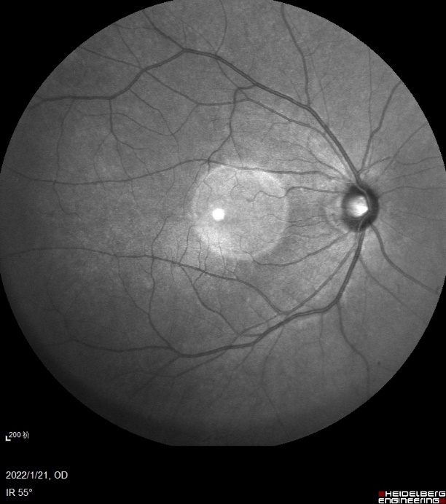
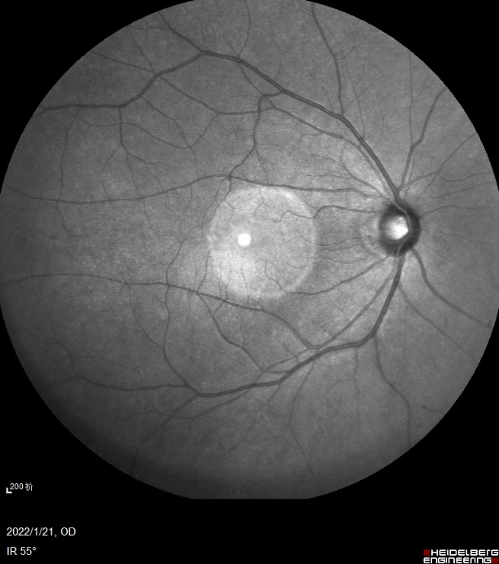

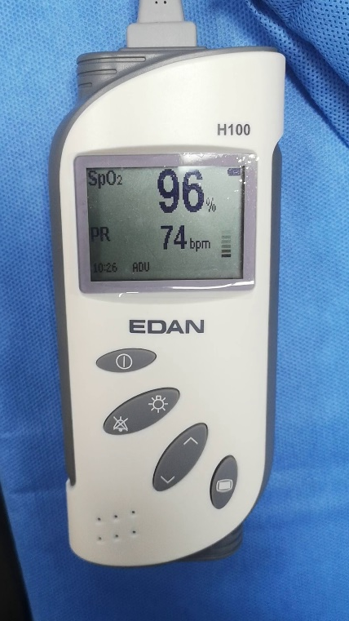
Fundus RPPG
Fundus video
HR & SpO₂
8 Samples:
2 males and 2 females
Fundus video
HR & SpO₂

Slide 48
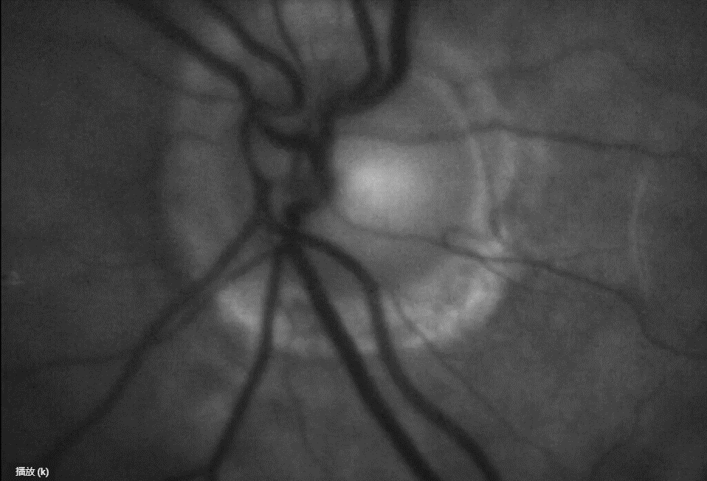
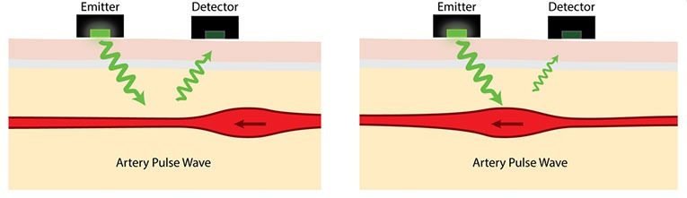
Fundus RPPG
Blood volume
Optic Cup Pulsations(OCP)

Slide 49
Problems
1、Insufficient fundus video frame rate(10 frames per second)
2、Video jitter
3、Noise interference and Low resolution
4、Manual/Semi-automatic analysis (Manual marking of arteries and veins)

Slide 50
Procedure
Vessel segmentation & A/V classification
Preprocessing
Image registration
Signal processing
Optic cup segmentation
1、Super resolution
2、Improve video frame rate

Slide 51
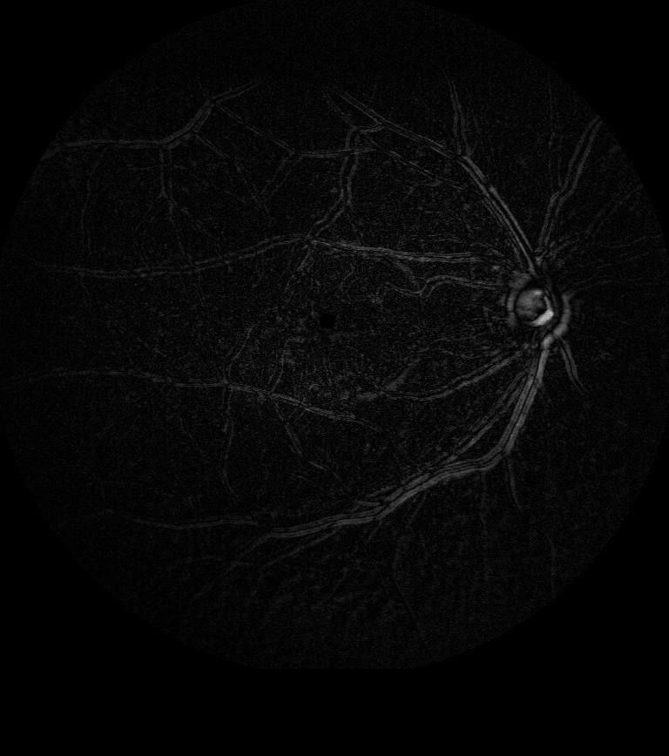
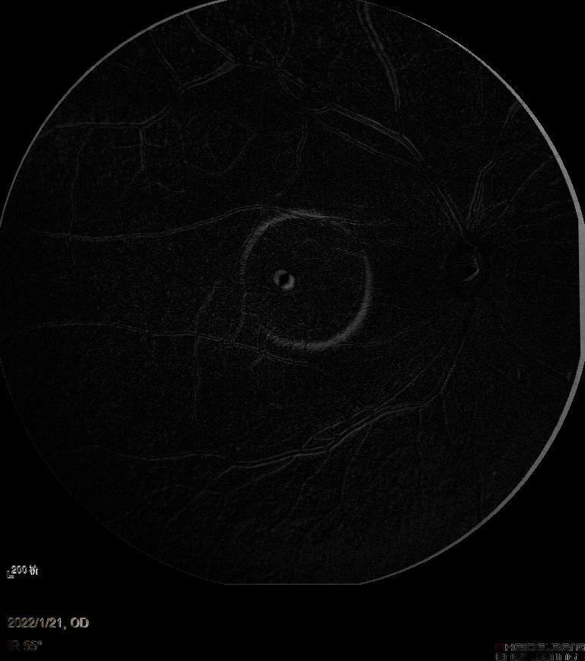
Image registration
After registration

Slide 52

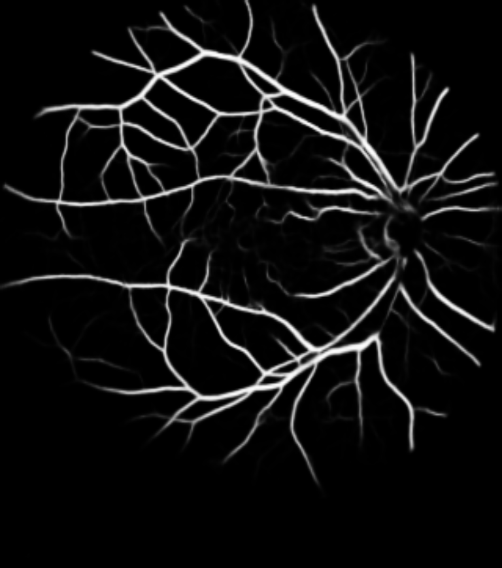
Vessel segmentation

Slide 53
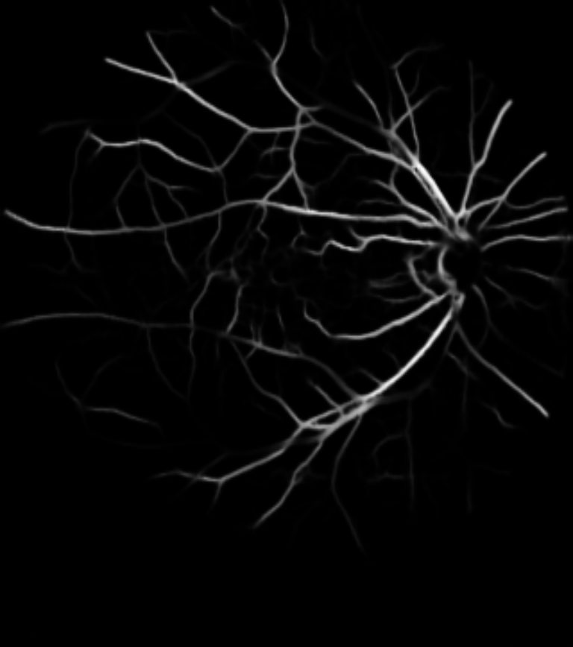
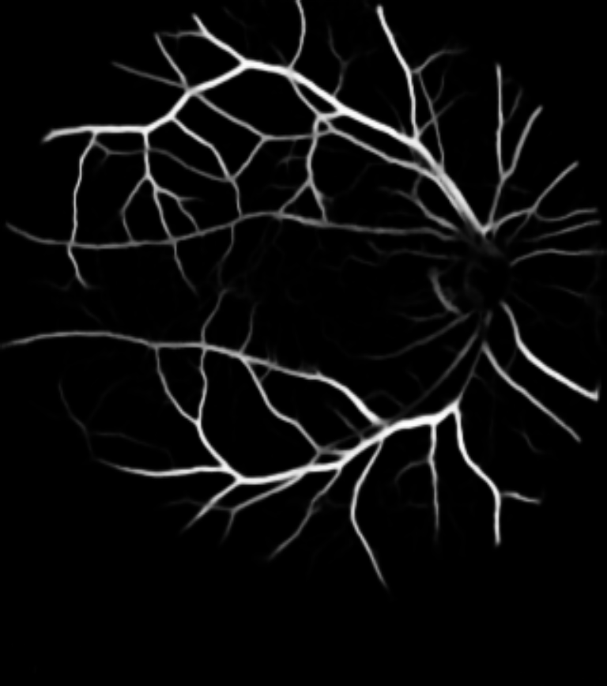
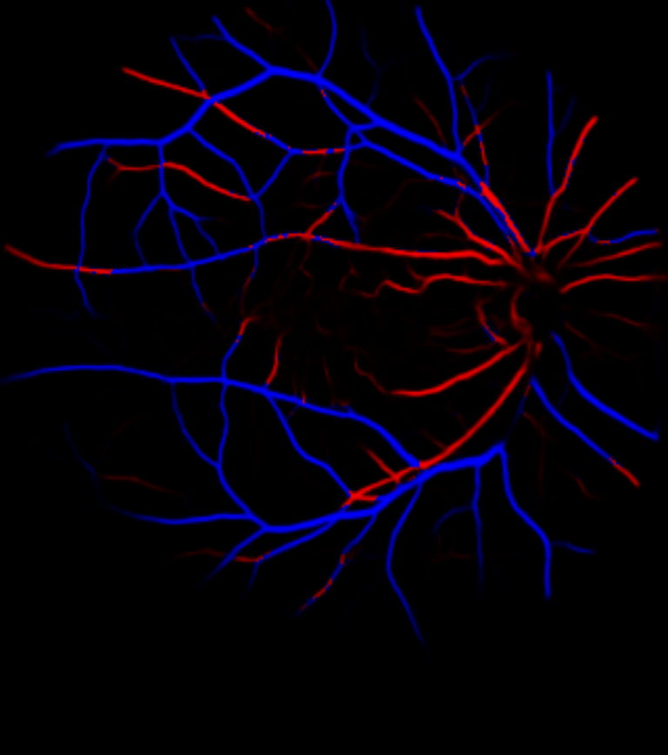
Artery/Vein classification

Slide 54
Future plan
1、Data preprocessing
2、More accurate model in every step
3、End-to-End detection model

Slide 55
Thanks & Questions?

